Slide 1
Hemophilia Guidelines for All
A new ambition of the World Federation of Hemophilia

Slide 2
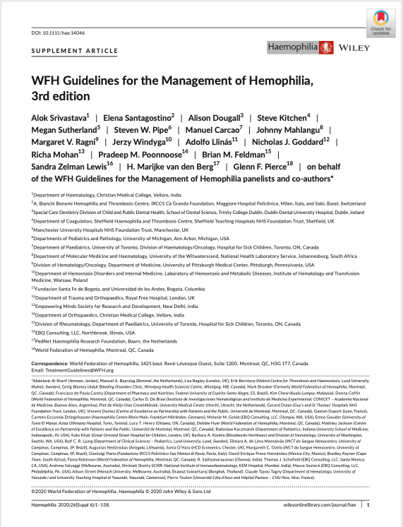
WFH Guidelines for the Management of Hemophilia
All recommendations are consensus based.
Srivastava A et al. Haemophilia. 2020;26(Suppl 6):1–158.

Slide 3
Chapter 12: Methodology
  Sandra Zelman Lewis PhD
  President, EBQ Consulting, LLC
  Evidence-Based guidelines and Quality improvement
  Northbrook, Illinois, United States

Slide 4
Disclosures: Sandra Zelman Lewis
Contracted by the WFH to serve as the Guidelines Consultant on this project.

Slide 5
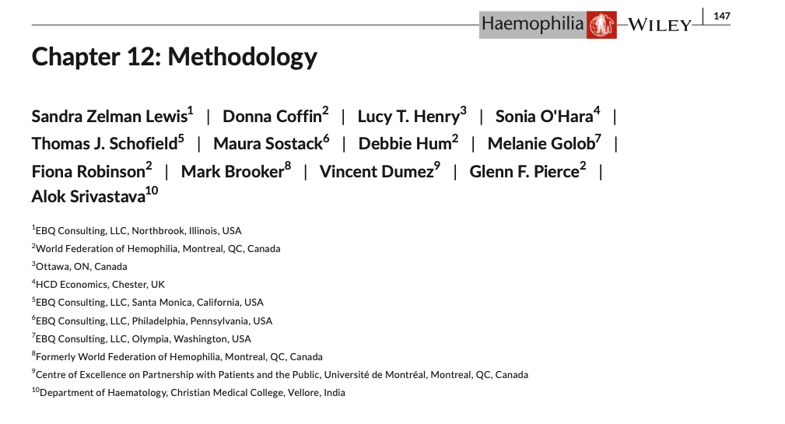
Authors
Sandra Zelman Lewis
Donna Coffin
Lucy T. Henry
Sonia O' Hara
Thomas J. Schofield
Maura Sostack
Debbie Hum
Melanie Golob
Fiona Robinson
Mark Brooker
Vincent Dumez
Glenn F. Pierce
Alok Srivastava

Slide 6
Background
The 3rd edition of the guidelines incorporates evidence based and Trustworthy Consensus-Based Statement approaches in conformance with established international standards
Limitations in evidence base in hemophilia include:
  Small samples and limited data
  Wide range in global practice
  Lack of feasibility for meta-analysis
TCBS is a systematic and trustworthy approach, incorporating available evidence and expert advice for unbiased recommendations
TCBS, Trustworthy Consensus-Based Statement.

Slide 7
Methodology
The TCBS process is founded on the following pillars:
Confidence in the panel composition and screening, including PWH and PPWH
Systematic and comprehensive evidence review
Formal consensus achievement through the modified Delphi approach
  The Delphi approach suppresses the introduction of group interaction bias
Transparency of data and methods throughout
Rigorous review process
PWH, person with hemophilia; PPWH, parent of person with hemophilia; TCBS, Trustworthy Consensus-Based Statement.

Slide 8
Composition of the panels
Structure and review
The panel was composed of content leads highly experienced in hemophilia, patient representatives and a methodology consultant with experience in guideline development
The WFH Guidelines Process Task Force was composed of members of the WFH Education Committee, including patients and a hematologist not involved in the development of the guidelines
The content lead and the previous WFH Vice President, Medical, offered initial invitations to the experts
An important goal was to ensure that no serious topic-related conflicts of interest existed for the leads and to minimize the percentage of the panel with any relevant conflicts

Slide 9
Composition of the panels
Structure and review
More than 50 panelists were assigned across 11 content chapters
Each chapter was assigned to a panel composed of 7-10 members, including:
  Chapter lead
  HCPs with clinical expertise from diverse healthcare disciplines
  PWH and caregivers, who made up at least 25% of each chapter panel
Panelists were recruited from diverse demographic, geographic, and socioeconomic contexts to ensure the global relevance
HCP, healthcare professional; PWH, person with hemophilia.

Slide 10
Process for panel workflow and oversight
The content and chapter leads guided the panels through the development process and provided content expertise
The responsibilities of the chapter leads included:
  Developing a comprehensive set of important subtopics
  Ensuring that the PWH/caregiver panelists’ perspectives were solicited and addressed
All panelists were involved throughout topic organization, evidence generation, consensus achievement of recommendations, and manuscript drafting and reviews
PWH, person with hemophilia.

Slide 11
Process for panel workflow and oversight
Training sessions emphasized:
The equal status of all panelists
The importance of each individual's expertise
The imperative for all panelists to work together to solicit and validate all perspectives
The patient partner facilitator supported the PWH/caregiver panelists throughout the guideline development process with monthly calls, guidance, and non-financial support, as needed
PWH, person with hemophilia.

Slide 12
Funding
The sole source of funding for these guidelines was the World Federation of Hemophilia
No external funding was permitted

Slide 13
Evidence generation
Systematic reviews of the published literature were conducted on 10 of the 11 content chapters by teams of qualified and experienced medical librarians, screeners, methodologists, and data extractors
  A review of the literature was deemed not relevant for the Principles of Care chapter, which focuses on ideal goals and aspirations given the current understanding of hemophilia and available science and technologies
Additional searches were developed specifically to target dental procedures, planned and emergent surgical and invasive procedures, and the emerging area of genetic assessment

Slide 14
Evidence generation
Study eligibility criteria
English language and human-only studies that included patients with hemophilia A or B were retained
Additional population criteria were established by chapter but there were no exclusions based on sex, age, geography, or type of care setting
Primarily searches extended back to 2000-2010 to the search date and were performed in the following major literature databases:
  PubMed
  The Cochrane Database of Systematic Reviews
  The Cochrane Central Register of Controlled Trials
  EMBASE

Slide 15
Evidence generation
Data extraction and development of evidence tables
A senior methodologist provided oversight and organization of the evidence tables
A team of 15 methodologists and data analysts extracted the relevant data from all included studies
No formal quantitative analyses were conducted, and no critical assessments were made of individual study quality
By design, no recommendations were graded

Slide 16
Formal consensus achievement
Draft recommendations went through the modified Delphi process guided by several a priori rules established by the Guidelines Process Task Force:
  Up to three rounds were permitted to achieve consensus
  Minimum response rate for each survey round was set at 75%
  The threshold for achieving consensus was 80% of the respondents indicating agreement or strong agreement
  Statements achieving consensus in the first or second round were not subjected to subsequent rounds
  No minority reports were permitted
Drafted recommendations that did not achieve consensus after three rounds do not appear as recommendations in the final guidelines
53 of 340 recommendations (15%) achieved consensus with at least one PWH/caregiver panelist selecting to opt out

Slide 17
Finalization of the recommendations and manuscript development
All recommendations that achieved consensus were incorporated within the relevant section of the manuscript, bolded, and numbered accordingly
  The WFH advises that as recommendations are uploaded into digital platforms, incorporated into separate lists, or otherwise removed from this full guideline publication, the remarks should always be kept with the rest of the recommendation as a single unit
Final manuscripts underwent extensive internal and external review, ensuring a global perspective
The guidelines are endorsed by the Asian-Pacific Society on Thrombosis and Hemostasis, European Haemophilia Consortium, and the National Hemophilia Foundation (USA)

Slide 18
Methodology limitations
As is common in guideline development, pragmatic adjustments were made to methodological processes and compromises required to provide best possible guidance
Panelists were invited without a rigorous review of conflicts of interest
Panelist input to the scope of chapter searches served as a proxy for a priori established PICO questions
Search strategies were developed based on scope discussions and early drafts; and searches were restricted to 2010-2019 for chapters revised from the previous edition
PICO, Population, Intervention, Comparators, Outcomes.

Slide 19
Methodology limitations
Studies identified as retrospective were excluded except where specified
Due to the high yield of references from the searches for the Prophylaxis in Hemophilia chapter, references were limited to studies with a minimum sample size of 40
Single screening, rather than dual screening with adjudication; and single data extractions, rather than dual extractions with adjudication, were necessary compromises
There were no critical appraisals of the quality of the evidence or assessments of the feasibility of quantitative analyses as these had been ruled out in advance

Slide 20
Future plans for updates
These guidelines represent a considerable advancement in the methodological quality and adhere to current standards for guideline development using the Trustworthy Consensus-Based Statement approach
As additional research is conducted in the field of hemophilia, and knowledge grows, published data should become more homogeneous and quantifiable, permitting more evidence-based guideline updates by the WFH in many of the content areas

Slide 21
Conclusions
This 3rd edition of the WFH Guidelines for the Management of Hemophilia is for healthcare professionals, PWH, healthcare agencies and advocates around the world
These are trustworthy, reliable, evidence-informed, and expert-driven recommendations that should inform and empower medical professionals, PWH and their caregivers so that they can be better informed and active participants in shared decision-making guiding hemophilia treatment and management plans
The WFH, guideline panelists, staff, and consultants did not receive any external funding for these guidelines
PWH, person with hemophilia.

Slide 22
Thank you to the Hemophilia Alliance for their support in developing this presentation

