Slide 1
Hemophilia Guidelines for All
A new ambition of the World Federation of Hemophilia

Slide 2
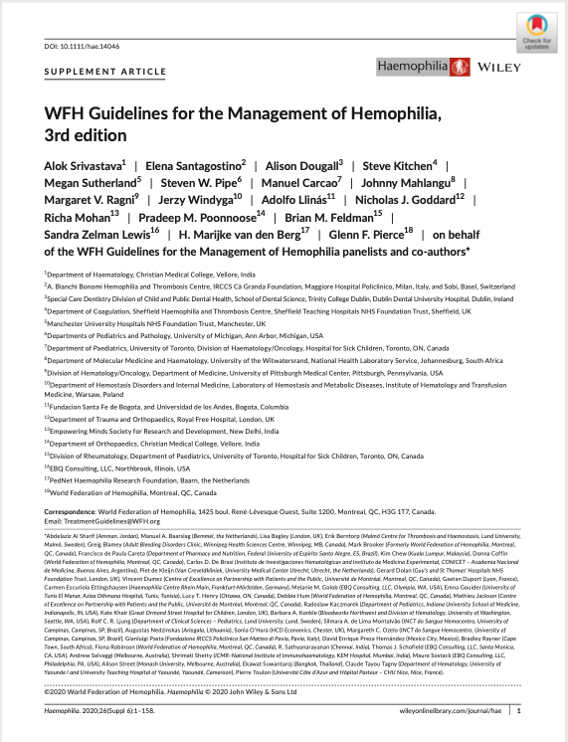
WFH Guidelines for the Management of Hemophilia
All recommendations are consensus based.
Srivastava A et al. Haemophilia. 2020;26(Suppl 6):1–158.

Slide 3
Chapter 2: Comprehensive Care of Hemophilia
Kate Khair, PhD Director of Research, Haemnet, London Centre for Outcomes and Experience Research in Children's Health, Illness and Disability (ORCHID), Great Ormond Street Hospital for Children London, UK

Slide 4
Disclosures: Kate Khair
Grant/Research Support
CSL Behring, Roche, Sobi, Takeda, Pfizer, uniQure
Sponsored lectures
Bayer, CSL Behring, Novo Nordisk, Roche, Sobi, Takeda, Pfizer, uniQure
Shareholder
Haemnet Ltd

Slide 5
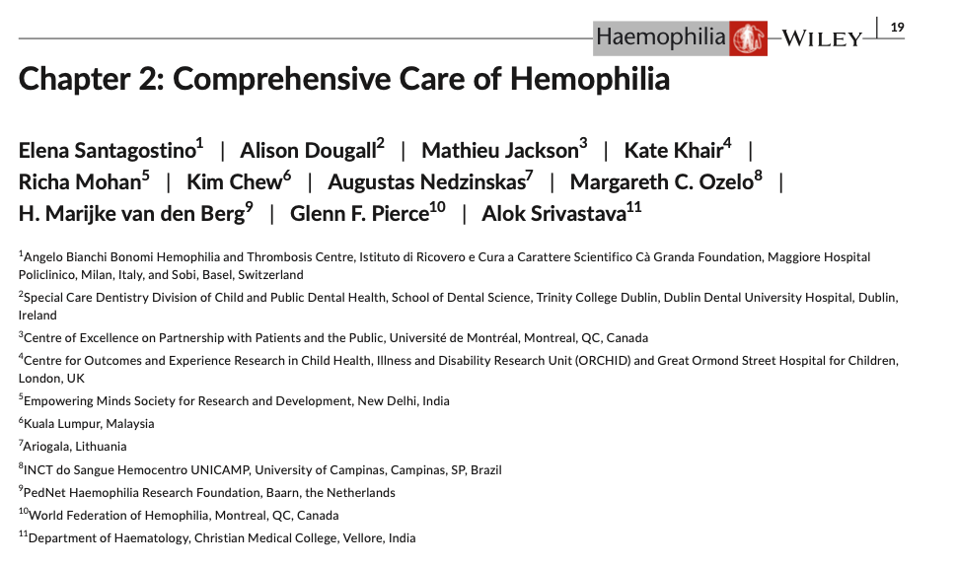
Authors
Elena Santagostino
Alison Dougall
Mathieu Jackson (PWH)
Kate Khair
Richa Mohan
Kim Chew (PWH)
Augustas Nedzinskas (PWH)
Margareth C. Ozelo
H. Marijke van den Berg
Glenn F. Pierce
Alok Srivastava
PWH, person with hemophilia.

Slide 6
Hemophilia A and B
Hemophilia is a rare X-linked congenital bleeding disorder
Hemophilia A is characterized by a deficiency of coagulation factor VIII (FVIII)
Hemophilia B is characterized by a deficiency of coagulation factor IX (FIX)
30% of all cases of hemophilia result due to a spontaneous genetic variant
50% of people newly diagnosed with severe hemophilia have no prior family history of hemophilia
Accurate diagnosis is essential to inform appropriate management.

Slide 7
Prevalence
 | Percentage of all patients | Prevalence /100,000 males | Prevalence at birth /100,000 males at birth
Hemophilia A | 80-85% | 17.1 | 24.6
Hemophilia B | 15-20% | 3.8 | 5
All | - | 21 | 30
Based on the prevalence of hemophilia, in 2020 the expected number of males with hemophilia was estimated to be 784,000, the majority of whom are undiagnosed.

Slide 8
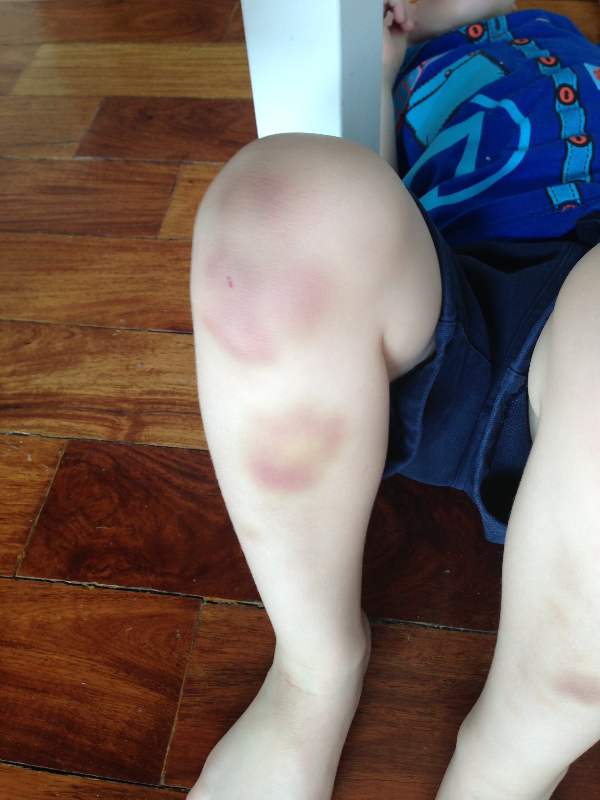
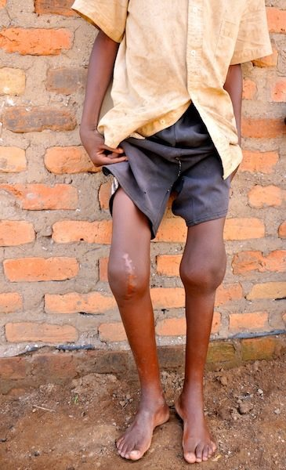
Clinical diagnosis
Main signs: easy bruising, “spontaneous” bleeding, and excessive bleeding
Symptoms of joint bleeds at a very young age are a key indicator of severe hemophilia, including:
Soft tissue and intramuscular bleeding
Bleeding associated with a medical procedure
Mucocutaneous bleeding
Intracranial bleeding

Slide 9
Bleeding manifestations
Severity | Clotting Factor Level | Bleeding episodes
Mild | 5-40 IU/dL | Severe bleeding with major trauma or surgery; rare spontaneous bleeding
Moderate | 1-5 IU/dL | Occasional spontaneous bleeding; prolonged bleeding with minor trauma or surgery
Severe | <1 IU/dL | Spontaneous bleeding into joints or muscles, predominantly in the absence of identifiable hemostatic challenge
Severity of bleeding correlates with the degree of clotting factor deficiency based on a factor assay to demonstrate deficiency of FVIII or FIX.

Slide 10
Comprehensive care Key components: the comprehensive care team
Physician
Recommendation 2.2.1 For people with hemophilia, the WFH recommends coordinated delivery of comprehensive care by a multidisciplinary team of healthcare professionals with expertise and experience in hemophilia.
Pathologist
Nurse
Physiotherapist
People with
hemophilia
Geneticist
Orthopedics
Social worker
Infectious disease

Slide 11
Comprehensive care
Recommendation 2.2.2 For people with hemophilia, the WFH recommends availability of and access to:
Appropriate emergency care at all times
Coagulation laboratory capable of performing clotting factor assays and inhibitor testing
Appropriate clotting factor concentrates (CFCs), either plasma- derived or recombinant, as well as other hemostatic agents such as desmopressin (DDAVP), emicizumab, and antifibrinolytics
… continued
CFCs, clotting factor concentrates; DDAVP, desmopressin.

Slide 12
Comprehensive care
Recommendation 2.2.2
Safe blood components such as fresh frozen plasma and cryoprecipitate that have been adequately screened, tested, and/or virus-inactivated if CFCs are not available
Casting and/or splinting for immobilization and mobility/support aids, as needed
Other specialists to address specific medical and health-related issues that some individuals may encounter, as needed.
CFC, clotting factor concentrate.

Slide 13
Comprehensive care Coordination and provision of care
Recommendation 2.2.4 For people with hemophilia, the WFH recommends a multidisciplinary checkup including hematologic, musculoskeletal, and quality-of-life assessments by the core comprehensive care team members at least yearly (every 6 months for children).
REMARK: Smaller centres and family physicians can provide primary care and management of some complications of hemophilia, in frequent consultation with the hemophilia comprehensive care team, especially for patients who live a long distance from the nearest hemophilia treatment centre.

Slide 14
Comprehensive care Patient registry and data collection
Recommendation 2.2.5 For all patients with hemophilia, the WFH recommends systematic data collection in patient registries, where possible, to inform allocation of resources, support improvement of care delivery services, and promote collaboration among centres in sharing data and conducting research.

Slide 15
Comprehensive care Patient/caregiver education and support
Recommendation 2.2.6 The WFH recommends that adequate education be provided to people with hemophilia, their family members, and other caregivers to enable self-management and sufficient understanding of the disease for prevention of bleeds and related complications and for life planning.
Recommendation 2.2.7 For people with hemophilia and their families, the WFH recommends promotion and/or facilitation of educational and recreational activities in collaboration with patient organizations, to provide them with opportunities to discover new interests and capabilities and build a support network with diverse members of the hemophilia community.

Slide 16

Fitness and physical activity
Recommendation 2.3.1 For people with hemophilia, the WFH recommends promotion of regular physical activity and fitness, with special attention on bone health maintenance, muscle strengthening, coordination, physical functioning, healthy body weight, and positive self-esteem.
Recommendation 2.3.2 For people with hemophilia, the WFH recommends promotion of non-contact sports. High-contact and collision sports and high-velocity activities should be avoided unless the individual is on a prophylactic regimen that is adequate to cover such activities and is properly educated on the potential risks and other required protective measures.
REMARK: The choice of sports activities should take into consideration the individual's physical condition and ability, preferences and interests, local customs, and available resources.

Slide 17
Fitness and physical activity
Recommendation 2.3.3 For people with hemophilia, the WFH recommends consultation with a physical therapist or other musculoskeletal specialist before engaging in sports and physical activities to discuss their appropriateness specific to the individual's condition and their requirement for particular physical skills and/or protective gear.
Custom-made dental mouthguards for all contact sports to prevent trauma and injury to teeth and oral soft tissues

Slide 18
Adjunctive management
Recommendation 2.4.1 For people with hemophilia with a muscle or joint bleed, the WFH recommends following the PRICE principles (protection, rest, ice, compression, and elevation) in addition to increasing factor level.
Recommendation 2.4.2 For people with hemophilia recovering from a joint or muscle bleed, the WFH recommends gradual re-initiation of physical activities under the supervision of a physical therapist with experience in hemophilia to assess resumption of normal motor development and coordination.
REMARK: For children with hemophilia recovering from a joint or muscle bleed, the physical therapist and family caregiver should remain in close contact to discuss and decide on the appropriate sports and activities for the child's progressive rehabilitation.
PRICE, protection, rest, ice, compression and elevation.

Slide 19
Adjunctive management
Recommendation 2.4.4 For people with hemophilia, the WFH recommends the use of antifibrinolytic drugs (e.g., tranexamic acid, epsilon aminocaproic acid [EACA]) alone or as adjuvant treatment, particularly in controlling mucosal bleeds and for invasive dental procedures.

Slide 20
Home therapy
Home therapy gives people with hemophilia immediate access to CFCs or other coagulation therapies and hemostatic agents
It enables optimal early treatment, resulting in less pain, dysfunction, long-term disability and reduced hospitalization for bleeding complications
For people with hemophilia, self-management requires concrete knowledge of bleeding mechanisms and treatment strategies
Patients and their caregivers should understand the differences, benefits, and any risks associated with a particular treatment.
Bleed recognition, especially of joint and muscle bleeds, is an essential part of self-management so that prompt treatment can be initiated to minimize the short- and long-term impacts of bleeds
CFC, clotting factor concentrate.

Slide 21
Home therapy Self management
Recommendation 2.5.1 Patients (or caregivers of children) with hemophilia should be taught how to manage their care at home and be able to demonstrate understanding of how to recognize bleeds and the ability to infuse or self-infuse, with monitoring of venous access skills over the patient's lifetime.
Recommendation 2.5.2 For patients with hemophilia, a detailed record of all treatments administered (reason, batch number, number of units, etc.) should be documented and used to personalize treatment plans.
Recommendation 2.5.3 For children with hemophilia, central venous access devices could be considered to facilitate early access to bleed treatment and prophylaxis.

Slide 22

Clinical case
Simon had moderate hemophilia
He lived a long way away from the hemophilia centre
Simon learnt that his bleeds got better more quickly when he recognised them early
Soon he realised that he got bleeds doing some activities, he talked to his hemophilia nurse and physio; and worked out a safe way to do his activities and how to treat himself at home
Living with hemophilia wasn’t so bad after all

Slide 23
Pain management Acute
Recommendation 2.6.1 For people with hemophilia with acute or chronic pain, the WFH recommends the use of age-appropriate pain assessment tools to determine the cause and guide appropriate management.
Recommendation 2.6.2 For people with hemophilia with venous access pain, discomfort or anxiety, the WFH recommends the application of a local anesthetic spray or cream at the site of venous access.

Slide 24
Pain management Acute
Recommendation 2.6.3 For people with hemophilia with acute pain due to a joint or muscle bleed, the WFH recommends immediate administration of clotting factor concentrates to stop bleeding, pain medication, and adjunctive measures such as immobilization, compression, and splinting to minimize pain, if appropriate.
Recommendation 2.6.10 For children and adults with hemophilia, the WFH recommends interim management of dental or orofacial pain according to a proportionate approach for pain relief and referral to a dental care professional for assessment.

Slide 25
Pain management Postoperative pain
Recommendation 2.6.4 For patients with hemophilia and postoperative pain, the WFH advises proportionate management of postoperative pain in coordination with the anesthesiologist or pain specialist.
Recommendation 2.6.5 For patients with hemophilia and postoperative pain, the WFH recommends analgesia similar to that used in patients without hemophilia including, as appropriate, the use of intravenous morphine or other narcotic analgesics, followed by an oral opioid (e.g., tramadol, codeine, hydrocodone, etc.) and paracetamol/acetaminophen as pain decreases
REMARK: With the exception of selective COX-2 inhibitors, NSAIDs should not be used in patients with hemophilia.
REMARK: The intramuscular route for administration of analgesia is not advised.
COX-2, cyclooxygenase-2; NSAIDs, nonsteroidal anti-inflammatory drugs.

Slide 26
Pain management Chronic hemophilic arthropathy
Recommendation 2.6.6 For people with hemophilia and chronic hemophilic arthropathy in need of pain management, the WFH recommends functional training and adaptations alongside appropriate analgesics.
Recommendation 2.6.7 For people with hemophilia and chronic hemophilic arthropathy, the WFH recommends education on pain management including the use of complementary pain management techniques (e.g., meditation, distraction, mindfulness, or music therapy).

Slide 27
Pain management Chronic hemophilic arthropathy
Recommendation 2.6.8 For children and adults with hemophilia with pain due to chronic hemophilic arthropathy, the WFH recommends the use of paracetamol/ acetaminophen, selective COX-2 inhibitors, tramadol, or morphine, and avoidance of other NSAIDs. Codeine may be used for children over 12 years of age but is contraindicated in younger children.
REMARK: Prolonged use of these medications may have risks of dependence or addiction, as well as organ damage, and must be carefully monitored.
REMARK: People with persistent pain should be referred to a specialized pain management team.
COX-2, cyclooxygenase-2; NSAIDs, nonsteroidal anti-inflammatory drugs.

Slide 28
Pain management Chronic hemophilic arthropathy
Recommendation 2.6.9 For patients with hemophilia with disabling pain from chronic hemophilic arthropathy, the WFH recommends referral to an orthopedic specialist for consideration of orthopedic surgery.

Slide 29

Dental care and management
Recommendation 2.7.2 For children with hemophilia, the WFH recommends referral to a designated dental care centre at the time of the first tooth eruption (around 6 months of age) or by age 1 in order to reduce the complications, morbidity, costs, and health and psychosocial impacts associated with oral diseases in people with hemophilia.
Recommendation 2.7.3 For adults with hemophilia, the WFH recommends facilitating access to appropriate adult dental services and procedures, with regular dental assessments throughout their lives to monitor and safeguard oral health using evidence-based and personalized preventive dental protocols.

Slide 30
Dental care and management
Recommendation 2.7.4 For people with hemophilia, the WFH recommends preventive dental and oral care as a priority to ensure optimal oral health and hygiene to prevent periodontal disease and dental caries, which predispose to gum bleeding, dental pain, tooth loss, chewing difficulties, and social impacts.

Slide 31
Dental care and management Oral care
Recommendation 2.7.5 For all people with hemophilia, the WFH recommends education on the importance of good oral hygiene to prevent dental problems and complications, including instructions for twice-daily brushing of the teeth using a soft- or medium-texture toothbrush and fluoridated toothpaste to remove plaque deposits; the toothpaste should not be rinsed away but rather retained (“spit, but don't rinse”) after brushing to maximize fluoride benefit.
REMARK: The use of dental floss or interdental brushes should be encouraged to ensure complete plaque removal.
REMARK: Individuals with elbow or shoulder restrictions may benefit from modified or electric toothbrushes and flossing aids.

Slide 32
Dental care and management Surgery and invasive procedures
Recommendation 2.7.7 For patients with hemophilia, the WFH recommends that dental extraction or other invasive procedures within the oral cavity (e.g., dental implantation, periodontal surgery, or gum biopsy) be performed only with a personalized plan for hemostasis management in consultation with a hematologist.
Recommendation 2.7.8 For patients with hemophilia, the WFH recommends the use of systemic or topical tranexamic acid or epsilon aminocaproic acid as adjunct treatment in the management of dental interventions pre- and postoperatively, to reduce the need for factor replacement therapy.
REMARK: Patients should be advised to maintain a soft diet and undertake careful brushing around the wound site for a minimum of 3-5 days postoperatively to avoid disturbing the clot and wound healing within the tooth socket.

Slide 33
Transition from pediatric to adult care
There are two transition periods that provide challenges for treatment adherence:
When adolescents switch to self-treatment
When young adults move away from home and assume full responsibility for self-care
To remedy this challenge, the key components of transition strategies are:
Developing a structured transition plan
Monitoring with systematic assessments of a patient’s readiness
Individualized support
Added support when switching to self-treatment or moving away from home

Slide 34
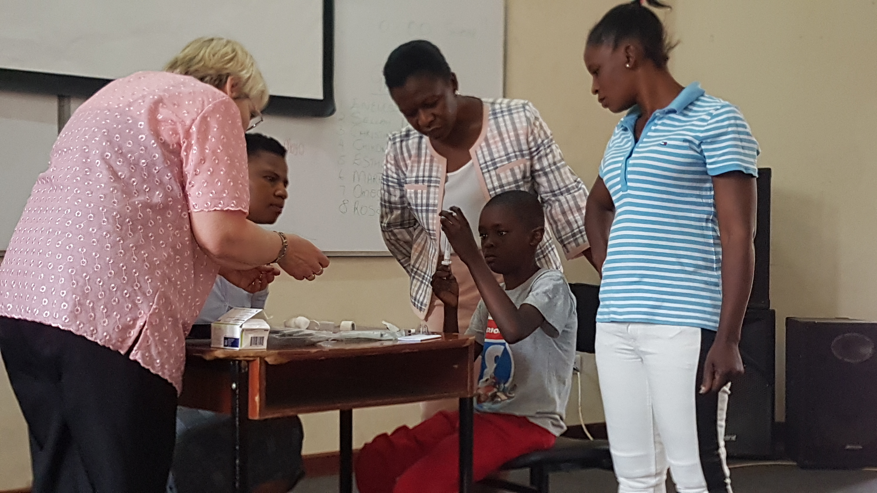
Clinical case
‘James’ was two when he was diagnosed with severe hemophilia
When he was ten, James went to summer camp and met other boys with hemophilia
By 16 he was able to manage his own care and understood the need for treatment
He became a ‘buddy’ for younger boys with hemophilia even after he moved to the adult hospital

Slide 35
Transition from pediatric to adult care
Recommendation 2.8.1 Children and adolescents with hemophilia should be supported with ongoing education and skills development, including the ability to self-infuse and other self-efficacy skills, to gain necessary hemophilia knowledge for self-management of their condition before they make the transition from pediatric to adult care.
REMARK: The comprehensive care team should support young patients and their families through the transition period. When possible, the first visit should be performed by both the pediatric and adult hematologists.

Slide 36
Transition from pediatric to adult care
Recommendation 2.8.2 For adolescents with hemophilia on prophylaxis, the WFH recommends individual education and training, ideally from a hemophilia nurse coordinator, to ensure adequate knowledge of hemophilia, and to support prophylaxis adherence and self-care management. This should include understanding measurements of adherence, as well as factors and risks that can lead to changes in bleeding rates.
Recommendation 2.8.3 For adolescents 12-18 years of age with hemophilia, the WFH recommends age-specific hemophilia camps to foster peer group support and develop their self-infusion skills and understanding of the importance of adherence to treatment.

Slide 37
Conclusions
Multi-disciplinary comprehensive care promotes best health care and outcomes for people with hemophilia and includes education and support of the affected individual and his family
Patient engagement with the comprehensive care team is important to ensue individualized, age-appropriate care for all affected people
Self-management skills should be taught for all people with hemophilia to ensure best outcomes and a life well lived

Slide 38
Thank you to the Hemophilia Alliance for their support in developing this presentation

