Slide 1
Hemophilia Guidelines for All
A new ambition of the World Federation of Hemophilia

Slide 2

WFH Guidelines for the Management of Hemophilia
All recommendations are consensus based.
Srivastava A et al. Haemophilia. 2020;26(Suppl 6):1–158.

Slide 3
Chapter 4: Genetic Assessment
Megan Sutherland PhD
Clinical Scientist, Genomic Diagnostics Laboratory, Manchester Centre for Genomic Medicine
Manchester University NHS Foundation Trust
Saint Mary’s Hospital
Manchester, United Kingdom

Slide 4
Disclosure: Megan Sutherland
No competing interests to declare.

Slide 5
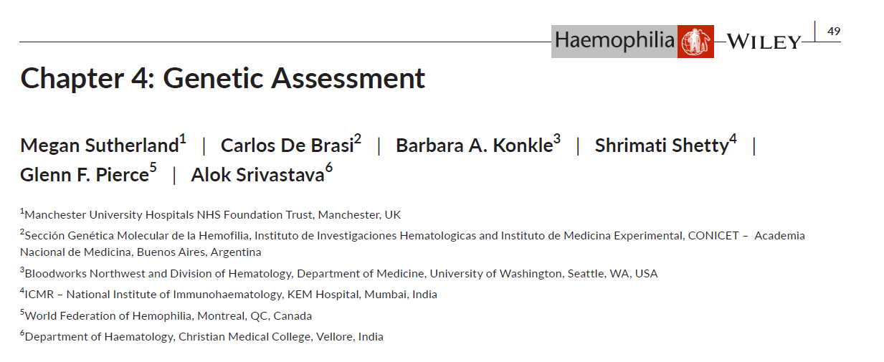
Authors
Megan Sutherland
Carlos De Brasi
Barbara A. Konkle
Shrimati Shetty
Glenn F. Pierce
Alok Srivastava

Slide 6
Genetic assessment of hemophilia is important in…
Defining disease biology
Establishing diagnosis in difficult cases
Predicting risk of inhibitor development
Identifying female carriers
Providing prenatal diagnosis, if desired

Slide 7


Who should be referred for genetic testing?
4.1.1
Suspected or established hemophilia
4.1.2
Obligate carriers and “at-risk” females
Test to identify the specific genetic variant
Test for previously identified genetic variant in the F8 or F9 gene
Prior to referral for genetic testing:
4.1.5
Phenotypic screening for:
FVIII or FIX levels, VWF antigen, and VWF activity testing
4.1.6
Genetic Counselling (pre and post testing, by genetic counsellor if available) for:
Limits of molecular results; possibility of incidental findings; consent; education
(Based on recommendations 4.1.1 - 4.1.6)
VWF, von Willebrand factor.

Slide 8
Approach to Genetic Testing for Hemophilia
Suspected or established hemophilia in index case
Severe or moderate hemophilia A
(lower FVIII borderline levels)
Mild or moderate hemophilia A
Mild, moderate or severe hemophilia B
Identify clinical phenotype
F8.22 – Southern blot or PCR (long-range or inverse-shifting)
F8.1 - PCR (double or inverse-shifting)
Full F8 gene screening†
Full F9 gene screening†
Baseline phenotypic coagulation factor
Screen for inversions (F8 introns 22 and 1)
Genetic counselling
(pre-test)
Screen for small variants*
Familial genetic variant known (obligate carriers and “at-risk” females)
Familial genetic variant unknown
Repeat genetic testing to confirm result
Screen for copy number variants**
Test genetic variant in the F8 or F9 gene
Stop
Screen for deep intronic variants‡
Consider mosaicism
Investigate differential diagnosis
Genetic counselling
(post-test)
†Depending on availability, full F8 or F9 gene screening is performed by PCR and Sanger sequencing or NGS for the detection of missense, nonsense, splice‐site, small and large deletions, duplications, and insertions; where resources are limited, laboratories may choose a cost‐effective screening approach prior to Sanger sequencing. *Small variants includes: SNVs and small insertions, duplications, or deletions covering the essential regions of F8 for hemophilia A (including the 26 exons) or F9 for hemophilia B (including the 8 exons), exon/intron boundaries, promotor and 5′ and 3′ untranslated regions. **Copy number variants include large F8 (hemophilia A) or F9 (hemophilia B) deletions, duplications, or complex rearrangements. ‡NGS and WGS techniques may be used, but only after it is established that structural variants can be detected by the technique. Based on Recommendation 4.2.
NGS, next-generation sequencing; PCR, polymerase chain reaction; SNV, single nucleotide variants; VWD, von Willebrand disease; WGS, whole genome sequencing.

Slide 9
Other considerations for techniques
When choosing an analytical technique, laboratories must be aware of the sensitivity and specificity of the approach used and the turn‐around time for producing an interpretive report
All results should be confirmed by independent analytical testing of the DNA sample
DNA, deoxyribonucleic acid.

Slide 10
Recommendations for Prenatal Diagnosis (PND)
It is important to be aware of and follow the relevant laws governing genetic counselling and pre-implantation genetic diagnosis in the country where the services are being provided
Why? | To terminate an affected male fetus (if desired) To guide the management of the delivery To predict the risk of inhibitor development, response to immune tolerance induction, and depth of phenotype severity, and determine the availability of gene manipulation techniques
Who? | Pregnant female carriers of an F8 or F9 variant carrying a male fetus Counselling should include a discussion of the risk of the PND procedure to the pregnancy
How? | In early pregnancy: by chorionic villus sampling or amniocentesis In late pregnancy: by late-gestation amniocentesis Test for maternal cell contamination testing of the fetal sample (multiple autosomal STR markers may be used)
PND, prenatal diagnosis; STR, short tandem repeat.

Slide 11
How to classify and describe variants
Recommendation 4.5.1 The WFH recommends that variants be classified per the American College of Medical Genetics and Genomics (ACMG) guidelines.*
Recommendation 4.5.2 The WFH recommends that variants be described using the Human Genome Variation Society (HGVS) nomenclature.
Providing corresponding F8 or F9 legacy nomenclature can be helpful to the clinician for comparison to prior patient or family clinical reports
Consult the sequence variant nomenclature system
http://www.HGVS.org/varnomen
*Please consult publication for associated remarks.

Slide 12
Interpretive reports
Recommendation 4.6.1
The WFH recommends that interpretive reports contain:
Patient information including patient name, date of birth, ordering clinician, date of specimen collection, diagnosis, baseline factor level, and family pedigree;
Description of the assay(s), references to the literature (if applicable), limitations of the test, and the genome reference sequence used for analysis;
Results including DNA variant(s) in HGVS nomenclature and ACMG variant classification
Interpretation of test results in a format useful to the ordering clinician, including recommendations for follow‐up testing if indicated, implications of test results for patients and family members, and the role of genetic counselling.
DNA, deoxyribonucleic acid; ACMG, American College of Medical Genetic and Genomics; HGVS, Human Genome Variation Society.

Slide 13
Interpretive reports
Recommendation 4.6.2 For all interpretive reports for all individuals undergoing genetic testing for hemophilia, the WFH recommends that the ordering clinician and reporting scientist be available to discuss the potential phenotypic consequences of the reported genotype, as required.

Slide 14
Strategies if causative variant is not detected
Recommendation 4.7.1 For people in whom a strong diagnosis of hemophilia is certain but no F8 or F9 variant is detected using current diagnostic genetic testing, the WFH recommends that other genetic causes be considered (e.g., deep intronic variants).*
Recommendation 4.7.2 For “at-risk” female relatives of people with hemophilia in whom the familial variant is not detected using standard diagnostic genetic testing, particularly in females with one affected child, the WFH recommends that the possibility of mosaicism be considered and discussed during genetic counselling.
*Please consult publication for associated remarks.

Slide 15
Strategies if causative variant is not detected
Recommendation 4.7.3
For people with hemophilia A in whom the mode of inheritance is not conclusive, and in whom no inversion or variant is detected by current diagnostic testing, the WFH recommends that other potential diagnoses be investigated, including type 2N VWD, combined FV and FVIII deficiency, or other types of VWD.
Recommendation 4.7.4
For symptomatic females with low phenotypic coagulation FVIII or FIX levels in whom just one pathogenic variant is found, the WFH recommends performing investigative tests for an X-chromosome inactivation pattern, if locally available.
VWD, von Willebrand disease.

Slide 16
Quality assurance
Recommendation 4.8.1 The WFH recommends that genetic diagnostic laboratories should undergo periodic accreditation, if available, by an approved body.
Recommendation 4.8.2 The WFH recommends that IQC of genetic tests be performed and recorded routinely within the laboratory.
Recommendation 4.8.3 The WFH recommends that laboratories participate in external quality assessment schemes (EQAS) for the genetic tests they provide.*
*Please consult publication for associated remarks.
IQC, internal quality control.

Slide 17
Clinical case: Hemophilia A
Index male with severe hemophilia A (FVIII:C <1 IU/dL)
No family history of hemophilia
Screening for the F8 intron 22 inversion identified hemizygosity for this variant in this patient – confirmed by repeat testing of the DNA sample
No further genetic testing required in this individual
Recommendations on the report:
This individual is hemizygous for the F8 intron 22 inversion, consistent with a diagnosis of severe hemophilia A.
This information can be used, if required, in female carrier studies within this family.
DNA, deoxyribonucleic acid.

Slide 18
Clinical case: Hemophilia B
Index male with mild hemophilia B (FIX 10 IU/dL)
Full F9 gene screen by PCR and Sanger sequencing
Identified a hemizygous variant in exon 4:
NM_000133.4:c.316G>A
p.(Gly106Ser)
ACMG classification – Pathogenic
Recommendations on the report:
This individual is hemizygous for the F9 pathogenic variant, consistent with his mild hemophilia B phenotype.
This information can be used, if required, in female carrier studies within this family.
PCR, polymerase chain reaction; ACMG, American college of medical genetics and genomics.

Slide 19
Clinical case: Severe Hemophilia A, no variant
Whilst this reduces the probability that she is a carrier of hemophilia A, the possibility that she is a germ-line or somatic mosaic for the variant cannot be excluded
Risk of having further affected children is reduced, but cannot be excluded
Genetic counselling is advised for this individual
Prenatal screening is advised for future pregnancies
This individual has severe hemophilia A patient (FVIII <1 IU/dL) and is positive for the F8 intron 22 inversion, however, Mom does not carry the familial variant.

Slide 20
Conclusions
Genotype analysis should be offered to all people with hemophilia and their “at-risk” female family members
Genetic counselling for people with hemophilia and their families is an essential requirement prior to genetic testing
Genetic diagnostic laboratories should adhere to strict protocols and procedures
The interpretation of the results of genetic testing should be performed by scientists who have knowledge and expertise in hemophilia genetics
The ordering clinician and reporting scientist should be available to discuss the potential phenotypic consequences of the reported genotype

Slide 21
Thank you to the Hemophilia Alliance for their support in developing this presentation

