Slide 1
Hemophilia Guidelines for All
A new ambition of the World Federation of Hemophilia

Slide 2
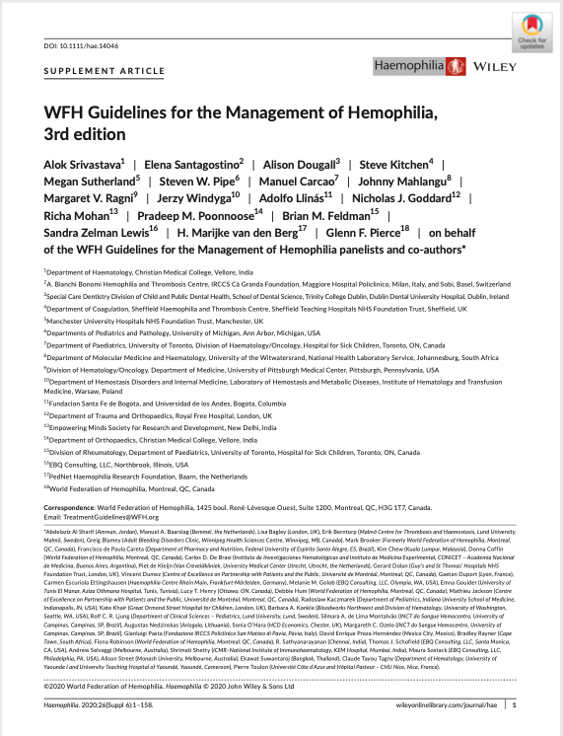
WFH Guidelines for the Management of Hemophilia
All recommendations are consensus based.
Srivastava A et al. Haemophilia. 2020;26(Suppl 6):1–158.

Slide 3
Chapter 5: Hemostatic Agents
Steven Pipe MD
Professor of Pediatrics and Pathology
Laurence A. Boxer Research Professor of Pediatrics and Communicable Diseases
Pediatric Medical Director, Hemophilia and Coagulation Disorders Program
Director, Special Coagulation Laboratory
University of Michigan, Ann Arbor, Michigan, United States

Slide 4
Disclosures: Steven Pipe
Grant/Research Support
Siemens
Consultant/Scientific board
Apcintex, Bayer, Biomarin, Catalyst Biosciences, CSL Behring, HEMA Biologics, Freeline, Novo Nordisk, Pfizer, Roche/Genentech, Sanofi, Takeda, Spark Therapeutics, uniQure
Advisory Committee
Sangamo Therapeutics (Scientific Advisor Board)

Slide 5
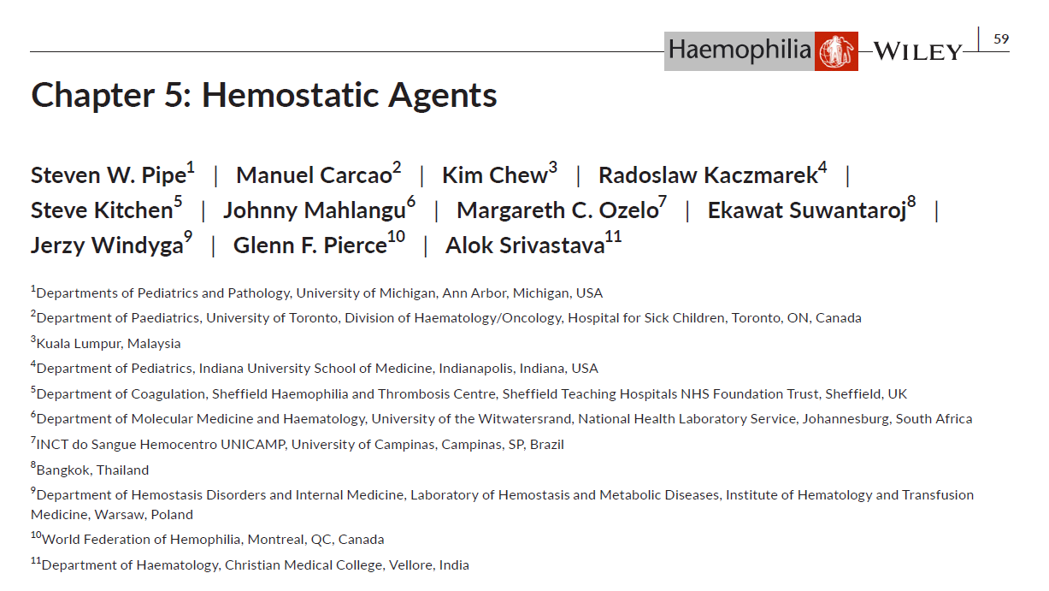
Authors
Steven W. Pipe
Manuel Carcao
Kim Chew (PPWH)
Radoslaw Kaczmarek (PWH)
Steve Kitchen
Johnny Mahlangu
Margareth C. Ozelo
Ekawat Suwantaroj (PWH)
Jerzy Windyga
Glenn F. Pierce
Alok Srivastava
PWH, person with hemophilia; PPWH, parent of person with hemophilia.

Slide 6
Introduction – Hemostatic Agents for Hemophilia
Clotting factor concentrates
Non-factor replacement therapies such as emicizumab offers an alternative treatment
Where access to CFCs and emicizumab is limited, healthcare providers often rely on cryoprecipitate and fresh frozen plasma for hemophilia treatment
Two Main Types of CFCs
Plasma-derived products
made from plasma donated by human blood donors
Recombinant products
manufactured using genetically engineered cells and recombinant
technology
CFC, clotting factor concentrate.

Slide 7
Clinical Case: Liam @ 9 months
Severe hemophilia A
Diagnosed at birth based on family history (maternal uncle and grandfather)
No FVIII exposures to date
Starting to show more bruising/hematomas over extremities now that he started crawling
Family ready to consider initiating prophylactic FVIII replacement therapy
Which product should be start for Liam?
Recombinant?
Plasma-derived?
Emicizumab?

Slide 8
Introduction
Recommendation 5.1.1 For patients with hemophilia, the WFH does not express a preference for recombinant over plasma-derived factor concentrates.
REMARK: The choice between these classes of product must be made according to local criteria including availability, cost, and patient preferences.

Slide 9
Product selection
Improvements in product safety due to:
Donor selection (exclusion of at-risk donors)
Screening of donations, including nucleic acid testing
Several in-process viral inactivation and/or removal steps
When selecting plasma-derived CFCs, two issues require special consideration:
Purity of product
Viral inactivation/elimination
Plasma-derived CFCs produced to GMP standards have an exemplary safety record with respect to viruses, such as HIV and HCV
CFC, clotting factor concentrate; GMP, Good Manufacturing Practices; HIV, human immunodeficiency virus; HCV, hepatitis C virus.

Slide 10
Product selection
Recommendation 5.2.1 For people with hemophilia, the WFH recommends the use of products that have been accepted by the official regulatory agencies responsible for protecting and promoting public health with consideration given to the plasma quality (i.e., purity of the product) and the manufacturing process (i.e., viral inactivation/elimination).*
REMARK: A plasma-derived product created by a process that incorporate two viral reduction steps should not automatically be considered better than one that only has one specific viral inactivation step. If only one step is used, this step should preferably inactivate viruses with and without lipid envelopes. Most recently, licensed products use two orthogonal viral inactivation/elimination steps.
*Please consult publication for additional associated remarks.

Slide 11
Clinical Case: James @ 16 months
Severe hemophilia A
Diagnosed at birth after bleeding circumcision
Presented at four months with intracranial hemorrhage, port placed for regular infusions
Developed a high titer FVIII inhibitor, had one year of attempt at immune tolerance induction but inhibitor remained refractory
Family no longer willing to continue intense infusion schedule
How should James be managed with a refractory FVIII inhibitor?

Slide 12
Bypassing agents
Recombinant activated factor VIIa
Promotes coagulation through tissue factor-dependent and independent pathways
Binds to tissue factor to activate FX and FIX and allows the coagulation cascade to resume
Activated prothrombin complex concentrate
Used to treat patients with hemophilia A with inhibitors
Contains non-activated FII (prothrombin), FIX, FX, and mainly activated FVII
Used for the treatment and prevention of bleeding complications in patients with hemophilia A or B who develop FVIII or FIX antibodies (inhibitors)

Slide 13
Bypassing agents
Recommendation 5.4.3 The WFH recommends that patients with hemophilia with an inhibitor should be considered for regular prophylaxis to prevent bleeding events.

Slide 14
Non-factor replacement therapies
Recommendation 5.7.1 For patients with hemophilia A with an inhibitor, the WFH recommends that emicizumab should be used for regular prophylaxis.
Specific recommendations regarding use of emicizumab are covered in chapters:
2 - Comprehensive Care of Hemophilia
6 - Prophylaxis in Hemophilia
8 - Inhibitors to Clotting Factor
9 - Specific Management Issues
REMARK: For patients with hemophilia A with no inhibitor, the WFH recommends that emicizumab can be used for regular prophylaxis.

Slide 15
Clinical Case: For advocacy
Henry is leading a National Member Organization for a low to middle-income country
The National Member Organization is seeing increased coverage of care for patients with hemophilia
The initial outcome of interactions with the health authority have indicated that they are only willing to support the use of locally produced fresh frozen plasma or cryoprecipitate for this patient population
What are the current WFH recommendations regarding this?

Slide 16
Other plasma products
Fresh frozen plasma and cryoprecipitate are not normally subjected to viral inactivation procedures and carry an increased risk of transmission of viral pathogens.
To minimize the risk of transmission of viral pathogens:
Quarantine plasma until the donor has tested negative for antibodies to HIV, HCV, and HBV
Nucleic Acid Testing to detect viruses
Recommendation 5.5.1 For patients with hemophilia, the WFH strongly recommends the use of viral-inactivated plasma-derived or recombinant clotting factor concentrates in preference to cryoprecipitate or fresh frozen plasma.
HIV, human immunodeficiency virus; HCV, hepatitis C virus; HBV, hepatitis B virus.

Slide 17
Other plasma products Fresh frozen plasma
Cryoprecipitate is preferable to fresh frozen plasma for the treatment of hemophilia A
Fresh frozen plasma and cryo-poor plasma contain low levels of FIX and can be used to treat hemophilia B in resource-poor countries
Recommendation 5.5.2 For patients with hemophilia, fresh frozen plasma is not recommended due to concerns about the safety and quality.
REMARK: However, the WFH recognizes the as yet unavoidable reality of their continued use in some parts of the world where it is the only available or affordable treatment option.

Slide 18
Other plasma products Cryoprecipitate
Cryoprecipitate contains significant quantities of FVIII (3-10 IU/mL), VWF, fibrinogen, and FXIII, but not FIX nor FXI. The resultant supernatant is called cryo-poor plasma and contains other coagulation factors such as factors VII, IX, X, and XI
The use of viral inactivation procedures is strongly encouraged
Recommendation 5.5.3 For patients with hemophilia, cryoprecipitate is not recommended due to concerns about the safety and quality.
REMARK: The use of cryoprecipitate can only be justified in situations where clotting factor concentrates are not available as there is no proven advantage for their use over CFCs. It is strongly encouraged that viral-inactivation procedures be used, if available.
von Willebrand factor; CFCs, clotting factor concentrates.

Slide 19
Other pharmacological options
In addition to CFCs, other agents can be of great value in a significant proportion of cases. These include:
Desmopressin
Tranexamic acid (antifibrinolytic agent)
Epsilon aminocaproic acid (EACA)
CFCs, clotting factor concentrates.

Slide 20
Other pharmacological options Desmopressin (DDAVP)
DDAVP is a synthetic analogue of vasopressin that boosts plasma levels of FVIII and VWF
DDAVP may be the treatment of choice for patients with mild or moderate hemophilia A as it avoids the expense and risk of FVIII inhibitor development
DDAVP is for hemophilia A patients only and is useful in the treatment and prevention of bleeding in carriers of hemophilia A
Appropriate preparations include:
4 μg/mL for intravenous use;
15 μg/mL for intravenous and subcutaneous use;
150 μg per metered dose as nasal spray
See WFH Guidelines for full details of dosing
DDAVP, desmopressin; VWF; von Willebrand factor.

Slide 21
Other pharmacological options Desmopressin (DDAVP)
Recommendation 5.6.1 For patients with mild or moderate hemophilia A and carriers of hemophilia A, the WFH recommends considering desmopressin (DDAVP) as an option for treatment.
REMARK: The WFH recommends testing DDAVP prior to therapeutic use to evaluate the individual FVIII response. The decision to use DDAVP must be based on the patient's baseline FVIII activity, the increment achieved, and the duration of treatment required.
REMARK: In general, the most common adverse events observed are tachycardia, flushing, tremor, abdominal discomfort, and headache, especially during rapid infusion, and are mostly mild and transient. However, hypotension and/or severe hyponatremia can also occur.
REMARK: For pregnant women during labour and delivery, the WFH recommends caution in the use of DDAVP, and it should be avoided in pre-eclampsia and eclampsia.
REMARK: With more than 3 consecutive days of dosing, the therapeutic response may decrease (tachyphylaxis) and the risk of complications rises; thus, clotting factor concentrates may be needed when higher factor levels are required for a prolonged period.
DDAVP, desmopressin.

Slide 22
Other pharmacological options Tranexamic acid
Tranexamic acid is an antifibrinolytic agent that competitively inhibits the activation of plasminogen to plasmin
Tranexamic acid alone is of no value in the prevention of hemarthroses
Tranexamic acid is given as oral tablets (25 mg/kg/dose) 3-4 times daily
It can also be given by intravenous infusion (10 mg/kg/dose) 2-3 times daily or as an oral rinse
The dose must be reduced if there is renal impairment to avoid toxic accumulation
It may be given alone or together with standard doses of CFCs, including bypassing agents such as aPCC and rFVIIa
Tranexamic acid is contraindicated in patients with hemophilia B receiving PCCs
CFCs, clotting factor concentrates; aPCC, activated prothrombin complex concentrate; PCCs, prothrombin complex concentrates.

Slide 23
Other pharmacological options Tranexamic acid
Recommendation 5.6.6 For patients with hemophilia, the WFH recommends that antifibrinolytics are a valuable alternative to use alone or as adjuvant treatment, particularly in controlling mucocutaneous bleeding (e.g., epistaxis, oral and gastrointestinal bleeding, and menorrhagia) and for dental surgery and eruption or shedding of teeth.
REMARK: Antifibrinolytics can be used with standard doses of clotting factor concentrates, including bypassing agents. However, they should not be used with prothrombin complex concentrates due to the increased risk of thromboembolism.

Slide 24
Other pharmacological options Epsilon aminocaproic acid (EACA)
In adults, EACA is typically administered every 4-6 hours up to a maximum of 24 g/day:
Orally (100 mg/kg/dose up to a maximum of 2 g/dose) or
Intravenously (100 mg/kg/dose up to a maximum of 4 g/dose)
Gastrointestinal upset is common with EACA use
Myopathy is a rare adverse reaction
Full resolution may be expected once EACA treatment is stopped
EACA is less widely used than tranexamic acid as it has a shorter plasma half-life, lower potency, and higher toxicity
EACA, epsilon aminoproic acid.

Slide 25
Non-factor replacement therapies
New and emerging innovative therapeutics have been developed that overcome the limitations of current clotting factor replacement therapy and improved PK profiles
PK, pharmacokinetic.

Slide 26
Non-factor replacement therapies Substitution therapy
Emicizumab is a factor mimetic and the first and only licensed substitution therapy at the time of this publication (Aug 2020)
Emicizumab is a bispecific antibody that mimics the cofactor function of FVIII in patients with hemophilia A, with or without inhibitors
Key benefits:
subcutaneous route of administration
long half-life
high efficacy in bleed prevention
reduction of the frequency of bleeding episodes
Emicizumab is not intended to treat acute bleeding episodes
Caution is required when treating breakthrough bleeding episodes while on emicizumab due to risk of thrombotic events.

Slide 27
Clinical Case: William @ 8 years
Severe hemophilia A
On primary prophylaxis since infancy
SHL-FVIII qOD
Despite an aggressive regimen, he still has occasional breakthrough bleeds and family struggling with adherence
Would he benefit from an EHL product?
What regimen?
How to evaluate?
Does it matter which EHL-FVIII?
qOD, every other day; SHL, standard half-life; EHL, extended half-life.

Slide 28
Clotting factor concentrates
Recommendation 5.3.1 For people with hemophilia A receiving FVIII concentrates who would benefit from optimization of prophylaxis, the WFH recommends individualized pharmacokinetic (PK) monitoring.*
Recommendation 5.3.9 For patients with hemophilia B receiving FIX concentrates who would benefit from optimization of prophylaxis, the WFH recommends pharmacokinetic monitoring.
REMARK: Peak factor level should be measured 15-30 minutes after the infusion to verify calculated dose. Plasma half-life can be determined via full PK (10-11 blood samplings taken over a period of 32-96 hours), or with limited sampling in combination with population PK estimates.
*Please consult publication for additional remarks.
PK, pharmacokinetic.

Slide 29
Clotting factor concentrates Extended half-life products
The frequency of infusions using SHL CFCs is associated with an increased burden of treatment
This often leads to poor adherence to prophylaxis regimens
EHL products were developed to address the need to reduce the treatment burden of prophylaxis and to maintain higher factor trough levels to improve bleed prevention
SHL, standard half-life; CFC, clotting factor concentrate; EHL, extended half-life.

Slide 30
Clotting factor concentrates Extended half-life products
Recommendation 5.3.10 For patients with hemophilia A or B, there is no evidence for any clinical safety issues in persons with hemophilia to recommend a preference among the various mechanisms of action (e.g., PEGylation, Fc-fusion, albumin-fusion) used to extend the half-life of factor concentrates.
PEG, polyethylene glycol; Fc, fragment crystallizable of chimeric protein.

Slide 31
Clotting factor concentrates Switching
Recommendation 5.3.11 Patients with hemophilia who are transitioning from standard half-life factor concentrates to extended half-life factor concentrates would typically require decreased dose frequencies, but EHL products may also be used to maintain higher trough levels to optimize prophylaxis.
REMARK: Pharmacokinetic-guided dosing as per Recommendations 5.3.1 and 5.3.9 provides for more individualized prophylaxis.
EHL, extended half-life.

Slide 32
Conclusions
WFH continues to recommend viral-inactivated products over non-viral inactivated products
There is no preference between plasma derivate products or recombinant clotting factors
The use of SHL and EHL products allows for individualization and optimization of prophylaxis
There is controversy regarding recognition that in some countries they are still reliant on FFP and cryoprecipitates, despite the WFH recommendations
EHL, extended half-life; FFP, fresh frozen plasma; SHL, standard half-life.

Slide 33
Thank you to the Hemophilia Alliance for their support in developing this presentation

