Slide 1
Hemophilia Guidelines for All
A new ambition of the World Federation of Hemophilia

Slide 2
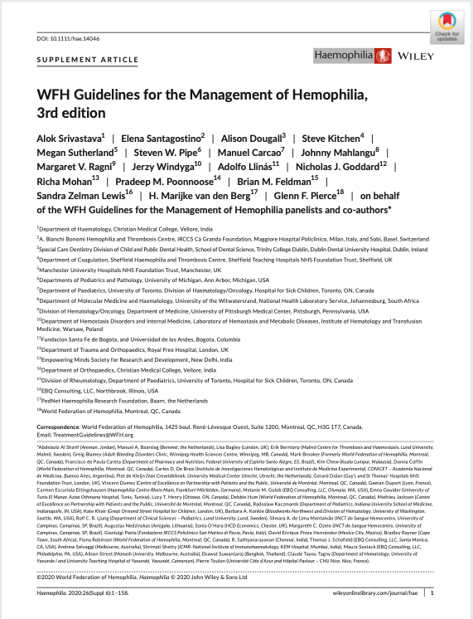
WFH Guidelines for the Management of Hemophilia
All recommendations are consensus based.
Srivastava A et al. Haemophilia. 2020;26(Suppl 6):1–158.

Slide 3
Chapter 6: Prophylaxis in Hemophilia
Manuel Carcao MD, MSc
Staff Haematologist
Co-Director, Hemophilia Clinic
Hospital for Sick Children
Professor of Paediatrics
University of Toronto
Toronto, Ontario, Canada

Slide 4
Disclosures: Manuel Carcao
Research Support from:
Bayer, Bioverativ/Sonofi, CSL-Behring, Novo Nordisk, Octapharma, Pfizer and Shire/Takeda
Honoraria for speaking/participating in advisory boards from:
Bayer, Bioverativ/Sonofi, Biotest, CSL Behring, Grifols, LFB, Novo Nordisk, Octapharma, Pfizer, Roche and Shire/Takeda

Slide 5
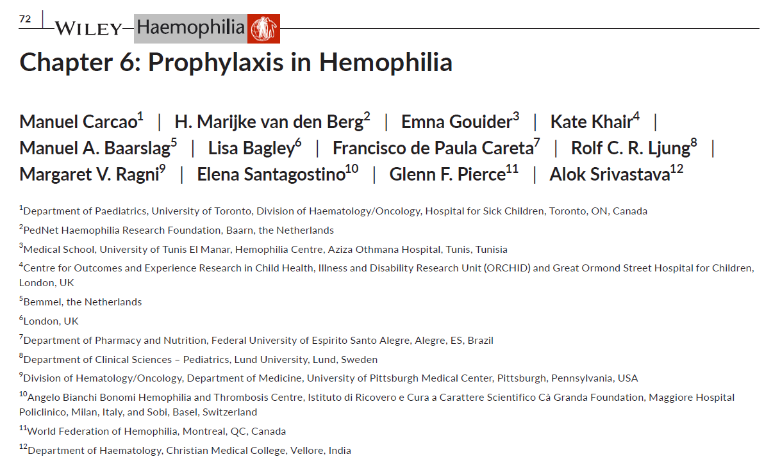
Authors
Manuel Carcao
H. Marijke van den Berg
Emna Gouider
Kate Khair
Manuel A. Baarslag (PWH)
Lisa Bagley (PPWH)
Francisco de Paula Careta (PWH)
Rolf C. R. Ljung
Margaret V. Ragni
Elena Santagostino
Glenn F. Pierce
Alok Srivastava
PWH, person with hemophilia, PPWH, parent of person with hemophilia.

Slide 6

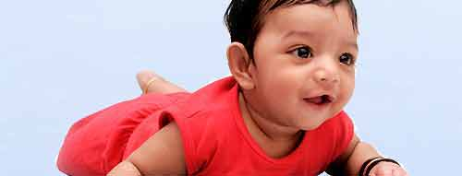
Hemophilia = life-long severe bleeding disorder
[without regular factor infusions=prophylaxis]

Slide 7

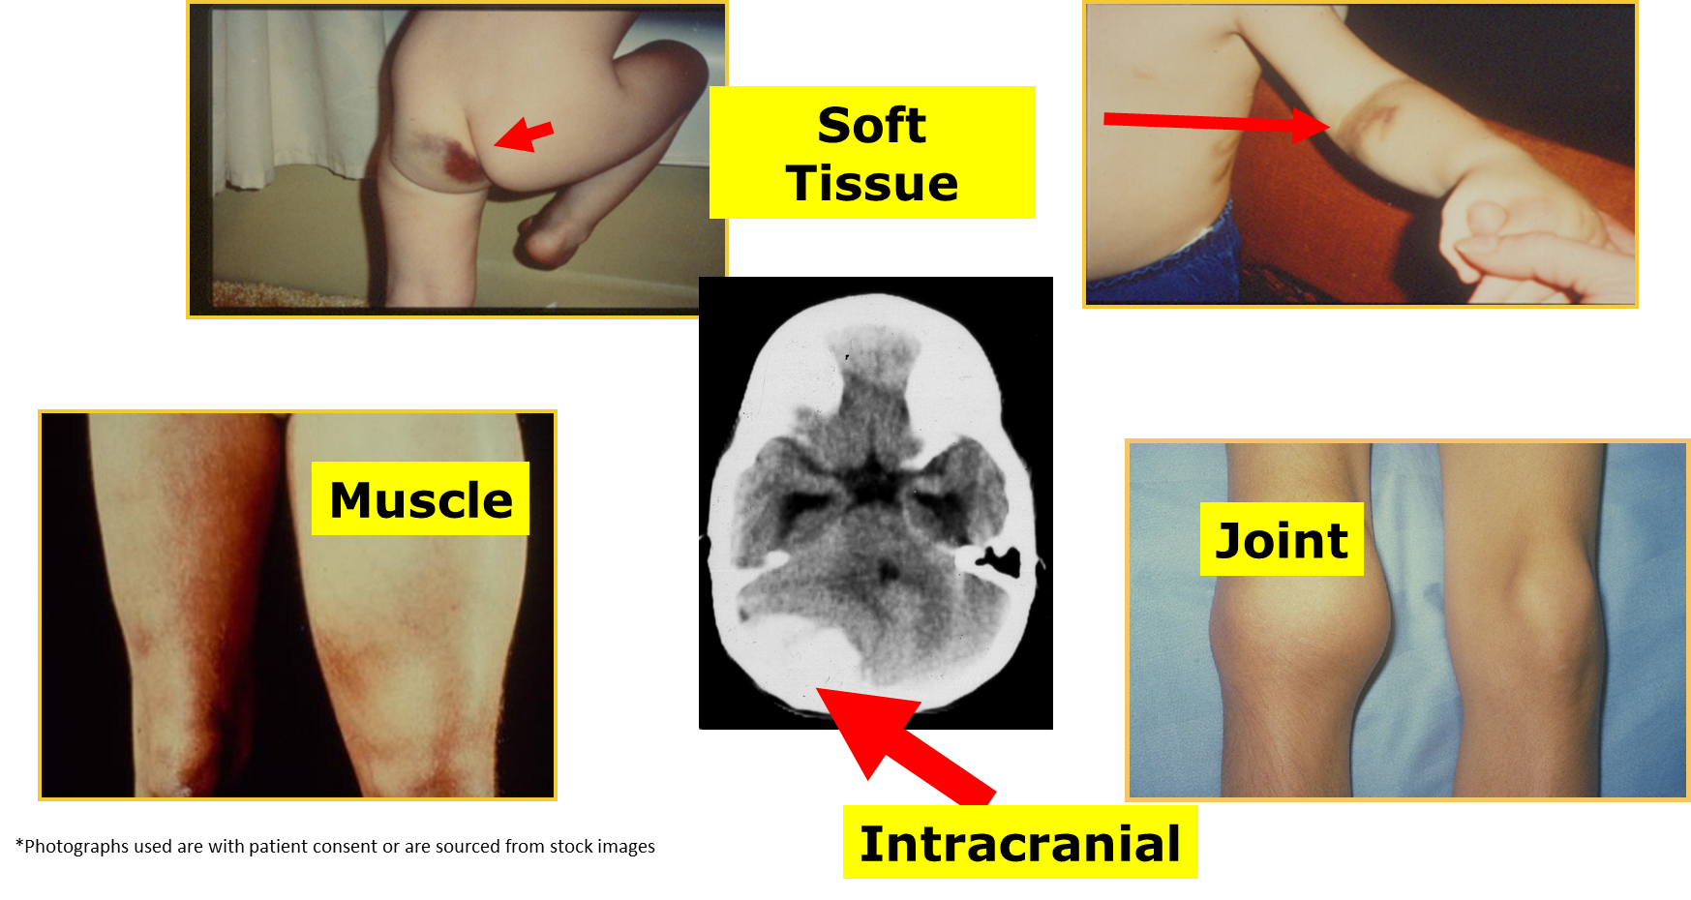
Hemophilia = life-long severe bleeding disorder
[without regular factor infusions=prophylaxis]
Soft tissue
Muscle
Joint
Intracranial

Slide 8
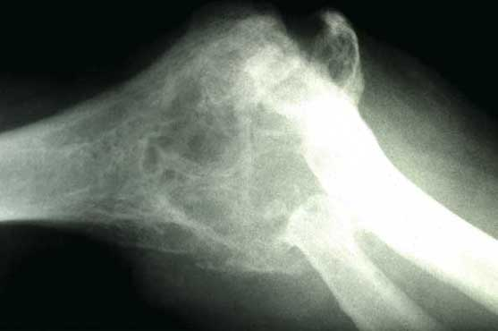
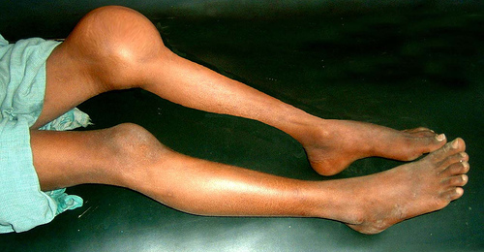
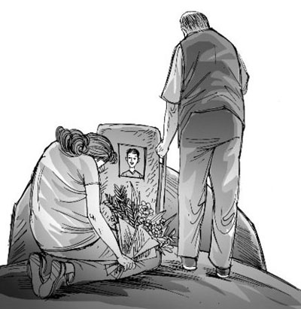
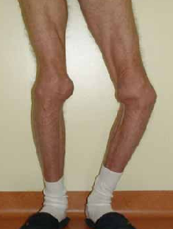
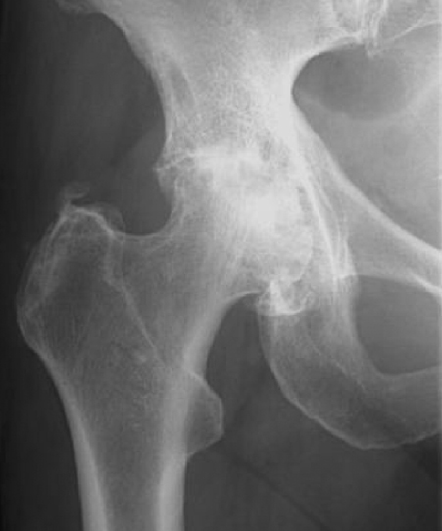
And this would lead to…
Destroyed joints
Pain & Disability
Early death

Slide 9
But with prophylaxis
They don’t have to experience
these things!

Slide 10
Prophylaxis with Standard T_{1/2} factor
➔huge⬇ in bleeding
Joint bleeds
adult+pediatric
Overall bleeds
pediatric
Overall bleeds
pediatric
Intermediate dose
Intermediate dose
Full dose

Slide 11
Prophylaxis with Standard T_{1/2} factor
➔huge⬇ in bleeding
Joint bleeds
adult+pediatric
Overall bleeds
pediatric
Overall bleeds
pediatric
-76%
-82%
-93%
Intermediate dose
Intermediate dose
Full dose

Slide 12
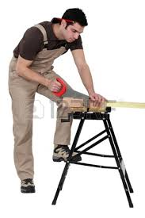

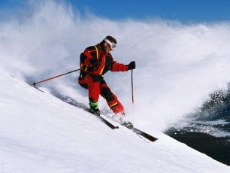
Prophylaxis with Standard T_{1/2} factor
➔huge improvements in quality of life
*Photographs used are with patient consent or are sourced from stock images

Slide 13
Prophylaxis is
standard of care
xx
Everywhere
WFH Guidelines
2020
(Prophylaxis)

Slide 14
Prophylaxis Standard of care-everywhere
“For patients with severe .. haemophilia A or B, especially children, the WFH recommends regular long-term prophylaxis as the standard of care …. When prophylaxis is not feasible, episodic (on demand) therapy is essential treatment for acute hemorrhages, but will NOT PREVENT long-term joint damage.”
WFH Guidelines
2020
(Prophylaxis)
Chapter 6: Prophylaxis in Hemophilia in
Srivastava A et al. WFH Guidelines for the Management of Hemophilia, 3rd ed, Haemophilia, 2020.

Slide 15
Prophylaxis Standard of care-everywhere
“In countries with significant healthcare constraints, the WFH still advocates for the use of prophylaxis over episodic (on demand) therapy but recognizes that less intensive prophylaxis may be used.”
WFH Guidelines
2020
(Prophylaxis)
Chapter 6: Prophylaxis in Hemophilia in
Srivastava A et al. WFH Guidelines for the Management of Hemophilia, 3rd ed, Haemophilia, 2020.

Slide 16
Prophylaxis Start early
… The WFH recommends early initiation of prophylaxis … prior to the onset of joint disease and ideally before age 3, …
WFH Guidelines
2020
(Prophylaxis)
(i.e. primary prophylaxis)
Chapter 6: Prophylaxis in Hemophilia in
Srivastava A et al. WFH Guidelines for the Management of Hemophilia, 3rd ed, Haemophilia, 2020.

Slide 17
Prophylaxis Aim to prevent all bleeds
“For patients with haemophilia A or B with a severe phenotype (may include patients with moderate haemophilia), the WFH strongly recommends that such patients be on prophylaxis sufficient to prevent bleeds at all times”
WFH Guidelines
2020
(Prophylaxis)
Chapter 6: Prophylaxis in Hemophilia in
Srivastava A et al. WFH Guidelines for the Management of Hemophilia, 3rd ed, Haemophilia, 2020.

Slide 18
Prophylaxis with Standard T_{1/2} factor
➔huge⬇ in bleeding
Overall bleeds
pediatric
Joint bleeds
adult+pediatric
Overall bleeds
pediatric
-76%
-82%
-93%
Intermediate dose
Intermediate dose
Full dose

Slide 19
Prophylaxis with Standard T_{1/2} factor
➔huge⬇ in bleeding
Overall bleeds
pediatric
Joint bleeds
adult+pediatric
Overall bleeds
pediatric
Intermediate dose
Intermediate dose
Full dose

Slide 20
Prophylaxis with Standard T_{1/2} factor
➔huge⬇ in bleeding
Overall bleeds
pediatric
Joint bleeds
adult+pediatric
Overall bleeds
pediatric
Not good enough!
Intermediate dose
Intermediate dose
Full dose

Slide 21
Prophylaxis with Standard T_{1/2} factor
➔huge⬇ in bleeding
Overall bleeds
pediatric
Joint bleeds
adult+pediatric
Overall bleeds
pediatric
Not good enough!
Okay but
Intermediate dose
Intermediate dose
Full dose

Slide 22
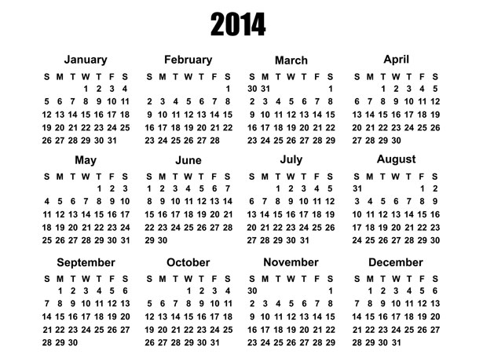
Full dose Prophylaxis with SHL-FVIII
(182 needles)

Slide 23
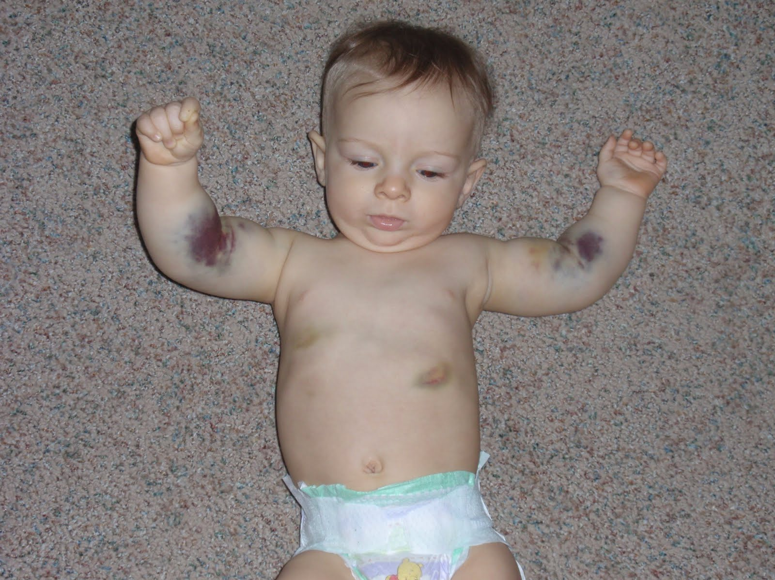
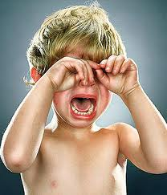
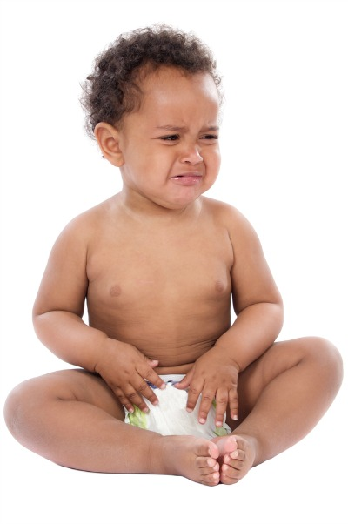
Even 1 needle is hard enough!
From venopunctures

Slide 24
Full dose Prophylaxis with SHL-FVIII – this is very hard
(182 needles)

Slide 25
Full dose Prophylaxis with SHL-FVIII – this is very hard
Missed doses

Slide 26
Full dose Prophylaxis with SHL-FVIII – this is very hard
Risk
Risk
Risk
Risk
Risk
Risk
Risk
Risk
Missed doses
Risk
Risk
Risk
Risk
Risk
Risk
Risk
Risk
Risk
Risk
Risk

Slide 27
Full dose Prophylaxis with SHL-FVIII – this is very hard
Risk
Risk
Risk
Risk
Risk
Risk
Risk
Risk
Missed doses
Risk
Risk
Risk
Risk
Risk
Patients need products that allow for
less infusions
Risk
Risk
Risk
Risk
Risk
Risk

Slide 28
Full dose Prophylaxis with SHL-FVIII – this is very hard
What do patients achieve with this?
(182 needles)

Slide 29
Full dose Prophylaxis with SHL-FVIII – this is very hard
What do patients achieve with this?
(182 needles)
Factor VIII Trough levels = 1-3%

Slide 30
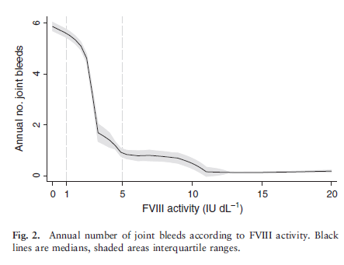
# of joint bleeds vs baseline FVIII
Trough Level = 1-3%
Den Uijl I et al. Hemophilia 2011.

Slide 31
# of joint bleeds vs baseline FVIII
Trough Level = 1-3%
Patients need higher trough levels
Den Uijl I et al. Hemophilia 2011.

Slide 32
Prophylaxis: Patients need more
1)
Less infusions
2)
Higher factor trough levels
3)
Non-IV administered
Or a combination
IV, intravenous.

Slide 33
Prophylaxis
we can now do
(and should do)
better
WFH Guidelines
2020
(Prophylaxis)
Chapter 6: Prophylaxis in Hemophilia in
Srivastava A et al. WFH Guidelines for the Management of Hemophilia, 3rd ed, Haemophilia, 2020.

Slide 34
Prophylaxis
we can now do
(and should do)
better
WFH Guidelines
2020
(Prophylaxis)
Chapter 6: Prophylaxis in Hemophilia in
Srivastava A et al. WFH Guidelines for the Management of Hemophilia, 3rd ed, Haemophilia, 2020.

Slide 35
Prophylaxis We can now do better
“Now recognizing that with a 1% trough level, patients remain at risk of bleeding, most clinicians would prefer to target higher trough levels (>3%-5%, or higher).”
WFH Guidelines
2020
(Prophylaxis)
Chapter 6: Prophylaxis in Hemophilia in
Srivastava A et al. WFH Guidelines for the Management of Hemophilia, 3rd ed, Haemophilia, 2020.

Slide 36
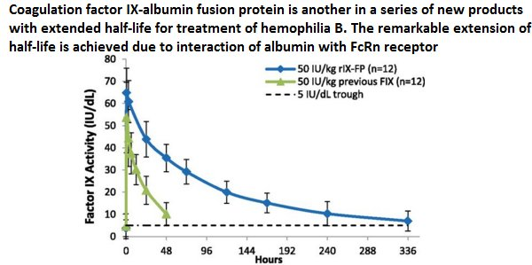
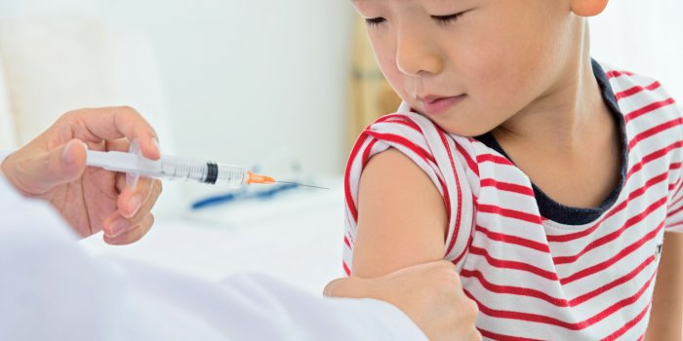
Prophylaxis We can now do better
Extended half-life (EHL) Clotting factor concentrates | Non-factor therapies (e.g. emicizumab)
Allow us to achieve better protection
than simply a 1% factor level

Slide 37

Benefits of Extended half-life (EHL) CFC
1)
Less infusions
2)
Higher factor trough levels
3)
Non-IV administered
Or a combination
IV, intravenous.

Slide 38
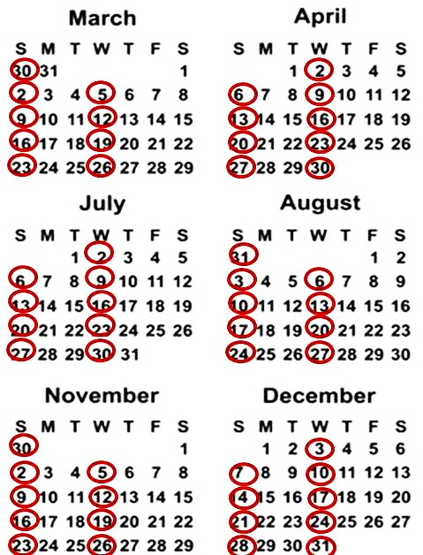
Current FVIII
EHL FVIII
For the average patient
No ⬆ in bleeding

Slide 39
Current FIX
EHL FIX
For the average patient
LESS BLEEDING

Slide 40
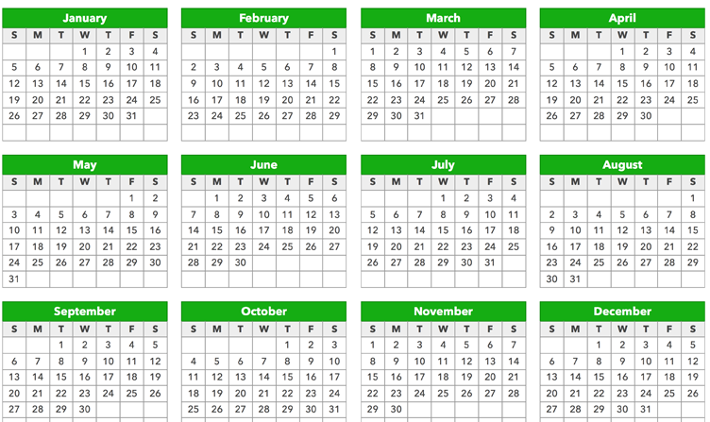

Emicizumab (SQ) prophylaxis
>90% ⬇ in bleeds (vs on demand)
52 times/yr

Slide 41
Emicizumab (SQ) prophylaxis
>90% ⬇ in bleeds (vs on demand)
26 times/yr

Slide 42

Benefits of Emicizumab
1)
Less infusions
2)
Higher factor trough levels
3)
Non-IV administered
Sort of!
Or a combination
IV, intravenous.

Slide 43

Prophylaxis No longer just factor
For patients with severe phenotype hemophilia A WITHOUT INHIBITORS, prophylaxis with emicizumab will prevent hemarthrosis, spontaneous, and breakthrough bleeding.
Remark: … long term data on patient outcomes with such an approach … be obtained.
WFH Guidelines
2020
(Prophylaxis)
Chapter 6: Prophylaxis in Hemophilia in
Srivastava A et al. WFH Guidelines for the Management of Hemophilia, 3rd ed, Haemophilia, 2020.

Slide 44
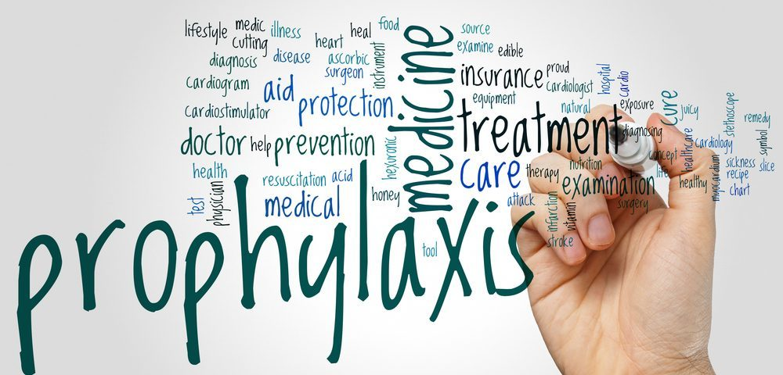
What is prophylaxis?

Slide 45

What is prophylaxis?
OLD
…the regular intravenous (IV) infusion of the missing clotting factor VIII (FVIII) in people with hemophilia A and factor IX (FIX) in people with hemophilia B, given in order to increase the FVIII/FIX level with the intent to prevent bleeding.
Blanchette VS, et al. Definitions in hemophilia: communication from the SSC of the ISTH. J Thromb Haemost. 2014;12(11):1935-1939.

Slide 46
What is prophylaxis?
OLD | NEW
…the regular intravenous (IV) infusion of the missing clotting factor VIII (FVIII) in people with hemophilia A and factor IX (FIX) in people with hemophilia B, given in order to increase the FVIII/FIX level with the intent to prevent bleeding.¹ | The regular administration of a hemostatic agent/ agents with the goal of preventing bleeding in people with hemophilia while allowing them to lead active lives and achieve quality of life comparable to non-hemophilic individuals.²
Blanchette VS, et al. Definitions in hemophilia: communication from the SSC of the ISTH. J Thromb Haemost. 2014;12(11):1935-1939.
Chapter 6: Prophylaxis in Hemophilia in Srivastava A et al. WFH Guidelines for the Management of Hemophilia, 3rd ed, Haemophilia, 2020.

Slide 47
Key recommendations: prophylaxis
WFH Guidelines
2020
(Prophylaxis)
Standard of care – everywhere
We can now do (and should do) better
No longer just factor

Slide 48
Key recommendations: prophylaxis
WFH Guidelines
2020
(Prophylaxis)
Can look forward to
a better life!

Slide 49
Thank you to the Hemophilia Alliance for their support in developing this presentation

