Slide 1
Hemophilia Guidelines for All
A new ambition of the World Federation of Hemophilia

Slide 2
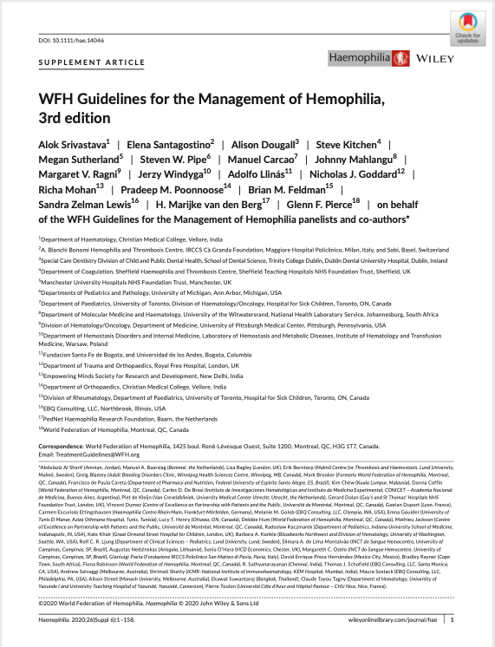
WFH Guidelines for the Management of Hemophilia
All recommendations are consensus based.
Srivastava A et al. Haemophilia. 2020;26(Suppl 6):1–158.

Slide 3
Chapter 7: Treatment of Specific Hemorrhages
Johnny Mahlangu BSc, MBBCh, MMed, FCPath Clinical Haematologist, Charlotte Maxeke Johannesburg Academic Hospital and Department of Molecular Medicine and Haematology Professor in Haematology, Faculty of the Health Sciences University of the Witwatersrand and National Health Laboratory Service Johannesburg, South Africa

Slide 4
Disclosures: Johnny Mahlangu
Grant/Research Support
Bayer, Biogen, BioMarin, CSL Behring, Novo Nordisk, Pfizer, Sobi, Roche, Unique
Consultant/Scientific board
Alnylam, Bayer, Biotest, Biogen, Baxalta, CSL Behring, Catalyst Biosciences, Novo Nordisk, Roche and Spark
Speaker bureau
Alnylam, Bayer, Biotest, Biogen, Novo Nordisk, Pfizer, Sobi, Shire, Roche, ISTH and WFH

Slide 5
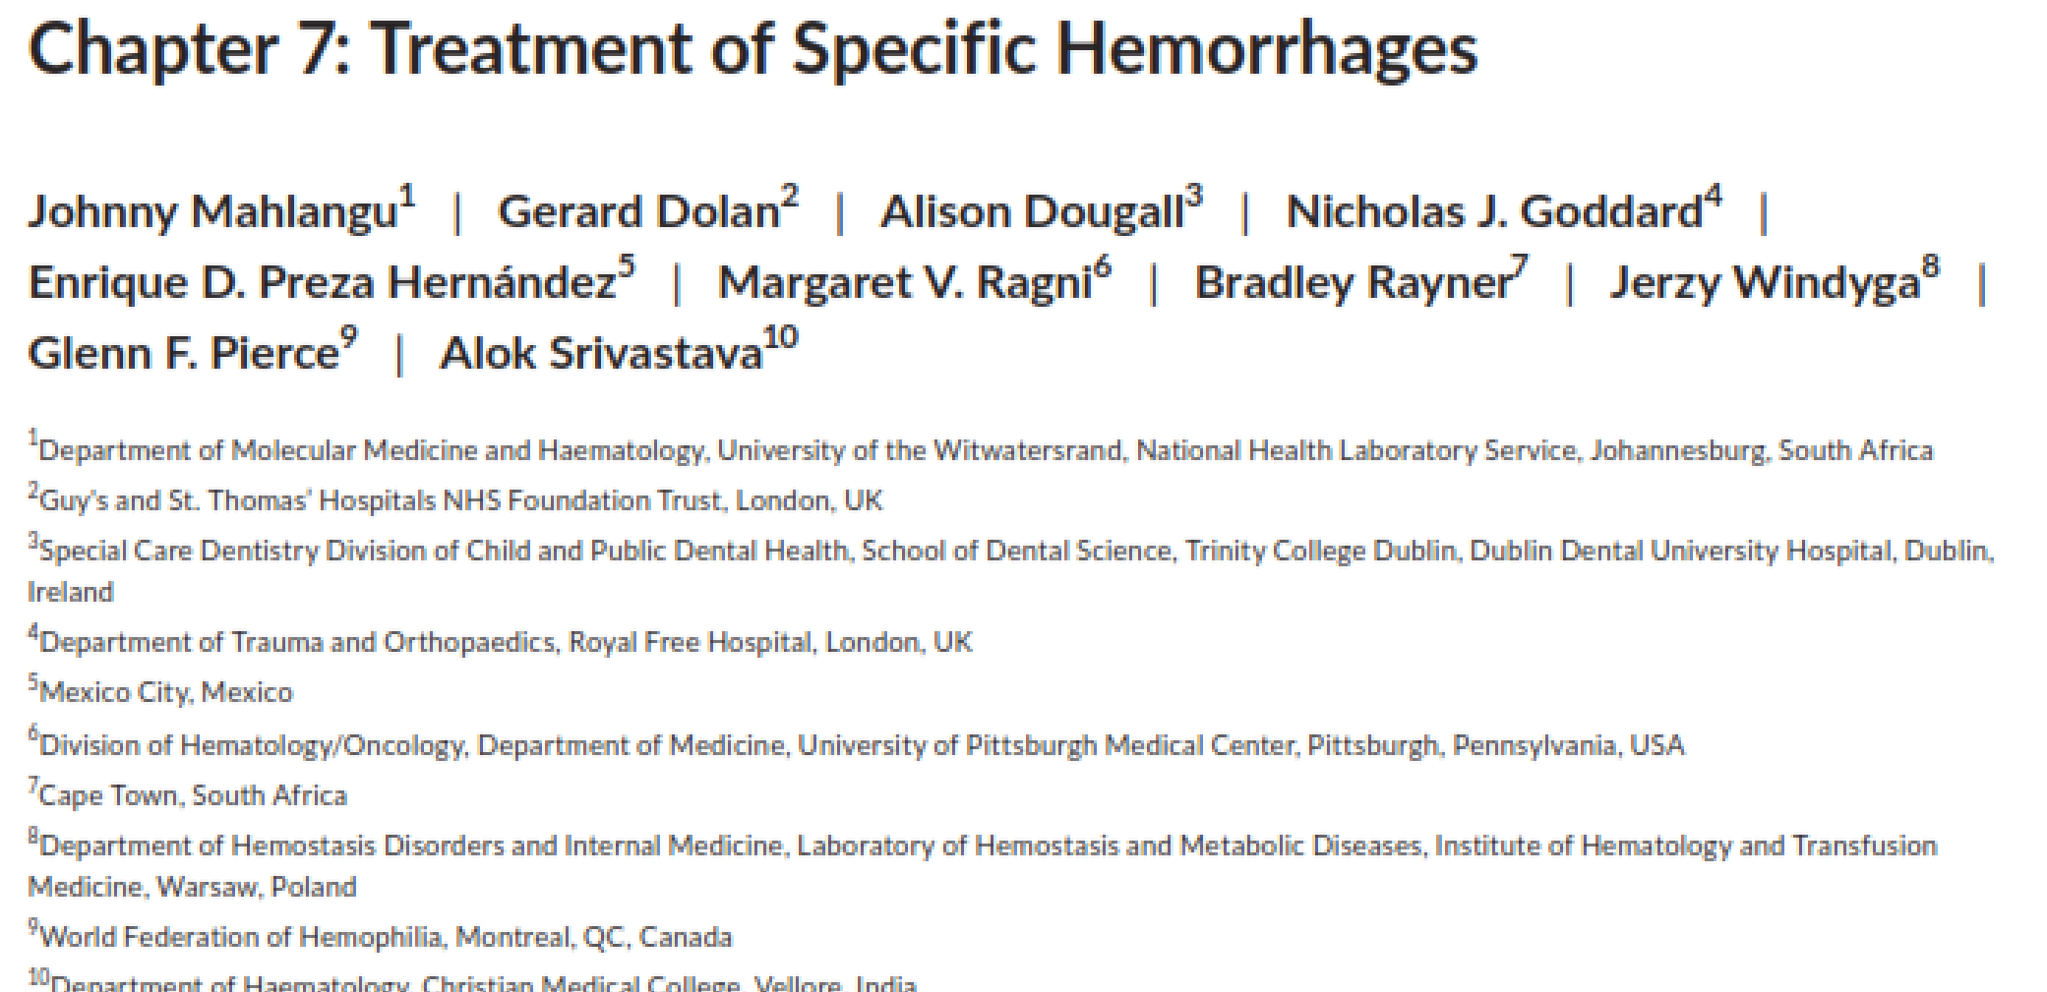
Authors
Johnny Mahlangu
Gerard Dolan
Alison Dougall
Nicholas J. Goddard
Margaret V. Ragni
Jerzy Windyga
Enrique D. Preza Hernández (PWH)
Bradley Rayner (PWH)
Glenn F. Pierce
Alok Srivastava
PWH, person with hemophilia.

Slide 6
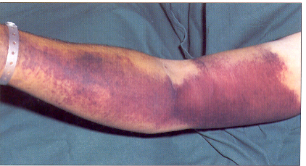
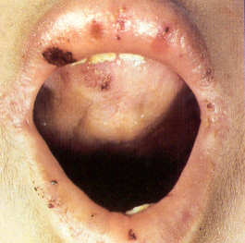
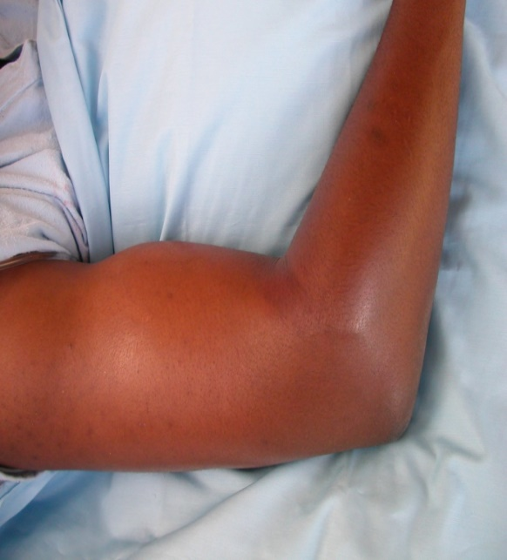
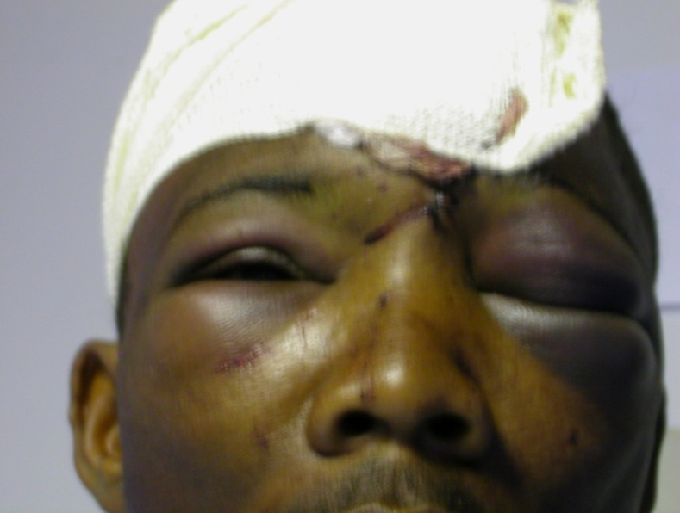
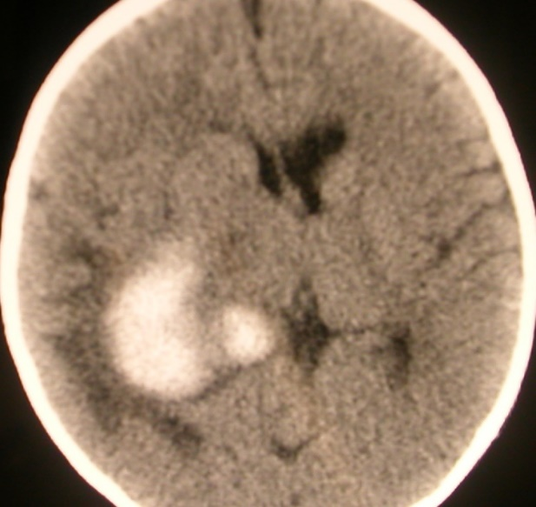
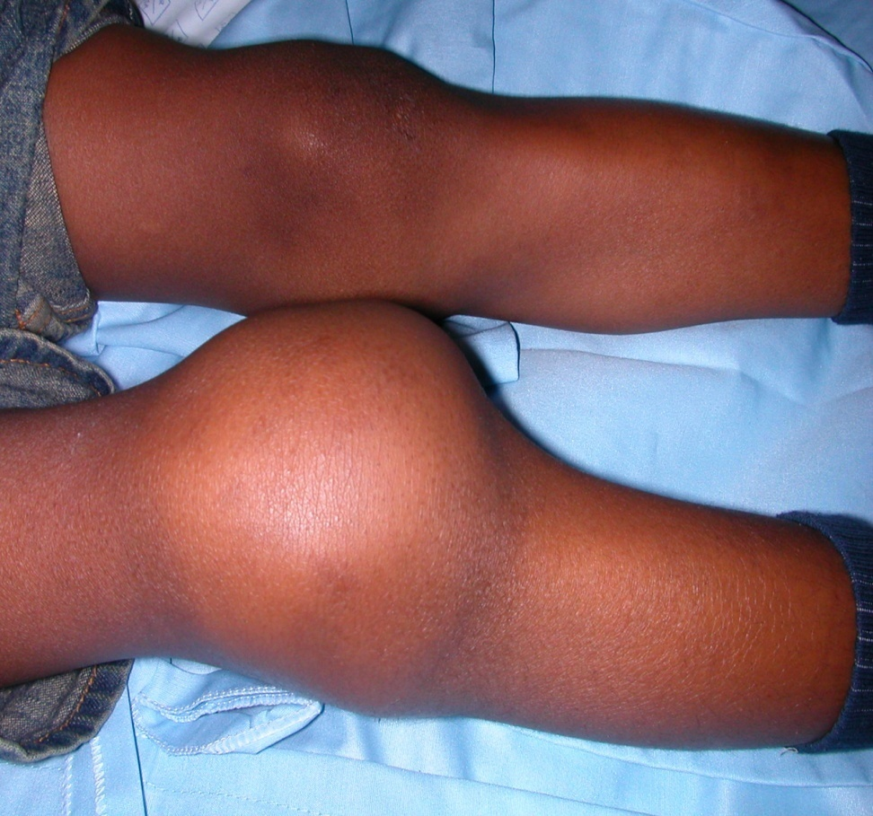
Bleeding in hemophilia is diverse

Slide 7
Different types of bleeds require specific management
Hemarthrosis
Soft tissues
Central Nervous System
Lacerations
Throat, neck
37 consensus recommendations
Epistaxis
GI bleeds
Oral
Ophthalmic
Renal
GI, gastrointestinal.

Slide 8
Benefits of early intervention
Short term benefits of early intervention
Fast pain relief
Early mobility
Reduced hospital visits
Lower rates of re-bleeds
Reduced drug required
Reduced costs
Longer term benefits of early intervention
Less Arthropathy
Less disability
Less orthopedic intervention
Improved quality of life

Slide 9
Specific bleeding sites
Hemarthrosis
Soft tissues
Central Nervous System
Lacerations
Throat, neck
37 consensus recommendations
Epistaxis
GI bleeds
Oral
Ophthalmic
Renal
GI, gastrointestinal.

Slide 10
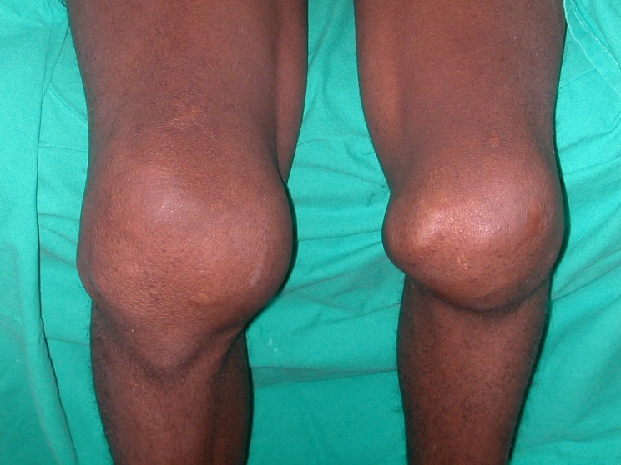
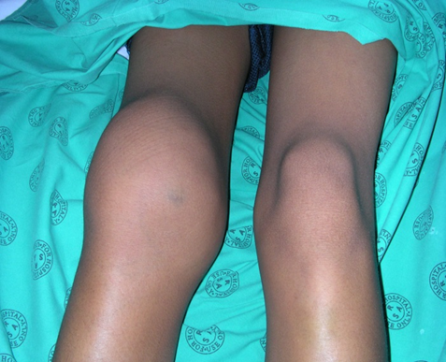
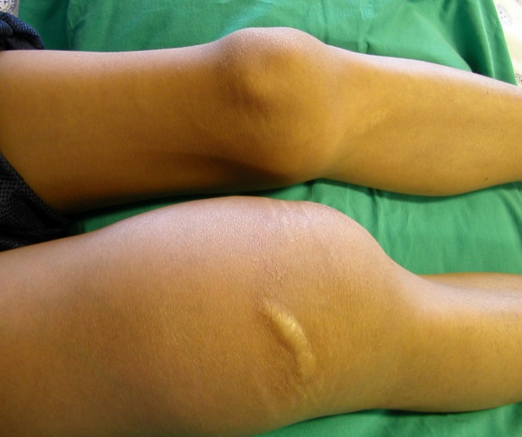
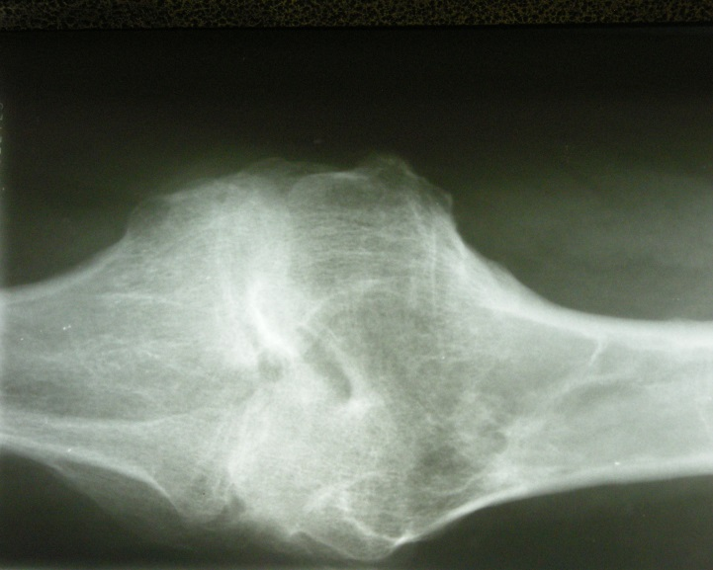
Clinical hallmark of haemophilia are hemarthroses
Replacement therapy is the treatment of choice for management of bleeds

Slide 11
Management of hemarthroses
Early diagnosis
Early treatment
Adjunctive therapy
Rehabilitation
Symptoms
Signs
Replacement therapy
Pain management
RICE
Arthrocentesis
ROM
Function
RICE, rest ice compression elevation; ROM, range of motion.

Slide 12
Management of hemarthroses
Early diagnosis
Early treatment
Adjunctive therapy
Rehabilitation
Symptoms
Signs
Replacement therapy
Pain management
RICE
Arthrocentesis
ROM
Function
RICE, rest ice compression elevation; ROM, range of motion.

Slide 13

Hemarthrosis Early diagnosis
A joint hemorrhage (hemarthrosis) is defined as an episode characterized by a combination of any of the following:
Increasing swelling or warmth of the skin over the joint
Increasing pain
Progressive loss of range of motion or difficulty in using the limb as compared with baseline
https://www.hemophiliafed.org/understanding-bleeding-disorders/complications/joint-damage/

Slide 14
Management of hemarthrosis
Early diagnosis
Early treatment
Adjunctive therapy
Rehabilitation
Symptoms
Signs
Replacement therapy
Pain management
RICE
Arthrocentesis
ROM
Function
RICE, rest ice compression elevation; ROM range of motion.

Slide 15
Hemarthrosis Early treatment
CFC dose should be sufficient to raise the patient's factor level high enough to stop the bleeding
Ultrasound is a useful tool to aid in the assessment of early hemarthrosis
Response to treatment is demonstrated by a decrease in pain and swelling
Recommendation 7.2.1 Hemophilia patients with severe hemarthrosis should be treated immediately with intravenous clotting factor concentrate replacement infusion(s) until there is bleed resolution.
Recommendation 7.2.2 Hemophilia patients with moderate or mild joint bleeding should be given 1 intravenous infusion of clotting factor concentrate, repeated if clinically indicated, depending on the resolution ofthe bleed.
CFC, clotting factor concentrate.

Slide 16
Hemarthrosis Response to treatment
Table 7.1
Excellent | Complete pain relief and / or complete resolution of signs of continuing bleeding after the initial infusion within 8h and not requiring any further factor replacement therapy within 72h after onset of bleeding
Good | Significant pain relief and / or improvement in signs of bleeding within approximately 8h after a single infusion but requiring more than 1 dose of factor replacement therapy within 72h for complete resolution
Moderate | Modest pain relief and / or improvement in signs of bleeding within approximately 8h after the initial infusion and requiring more than 1 infusion within 72h but without complete resolution
None | No or minimal improvement, or condition worsens, within approximately 8h after the initial infusion
Adapted from: Blanchette VS, Key NS, Ljung LR, et al. Definitions in hemophilia: communication from the SSC of the ISTH. J Thromb Haemost 2014;12(11):1935-1939.

Slide 17
Hemarthrosis Pain management
Recommendation 7.2.3 In hemophilia patients with hemarthrosis, severity of pain should be graded and monitored according to the World Health Organization (WHO) pain scale.
Recommendation 7.2.4 Hemophilia patients with pain due to hemarthrosis should be given analgesic medication according to the severity of the pain.
Analgesics: paracetamol/ acetaminophen, selective COX-2 inhibitors (not other NSAIDs), tramadol, or opioids
COX-2, cyclooxygenase-2; NSAIDs, nonsteroidal anti-inflammatory drugs.

Slide 18
Hemarthrosis Pain management
Recommendation 7.2.5 In hemophilia patients with severe pain, management of such pain should include opioids based on clinical symptoms to an extent that the patient is comfortable to weight bear or use the joint as much as possible without any pain.
Recommendation 7.2.8 In hemophilia patients, use of opioid analgesia in managing pain should be limited in duration, as much as possible.

Slide 19
Management of hemarthrosis
Early diagnosis
Early treatment
Adjunctive therapy
Rehabilitation
Symptoms
Signs
Replacement therapy
Pain management
RICE
Arthrocentesis
ROM
Function
RICE, rest ice compression elevation; ROM, range of motion.

Slide 20
Hemarthrosis Adjunctive Therapies
The application of ice has been shown to reduce acute pain
Depending on the site of the joint bleed, elevating the affected joint may help reduce swelling
Recommendation 7.2.6 Hemophilia patients with hemarthrosis should be managed using the RICE approach (Rest, Ice, Compression, and Elevation) in addition to clotting factor concentrate replacement.
REMARK: The WFH recognizes that in some regions of the world, RICE may be the only initial treatment available or the best treatment available in the absence of an adequate supply of CFCs or other hemostatic agents.
CFC, clotting factor concentrate.

Slide 21
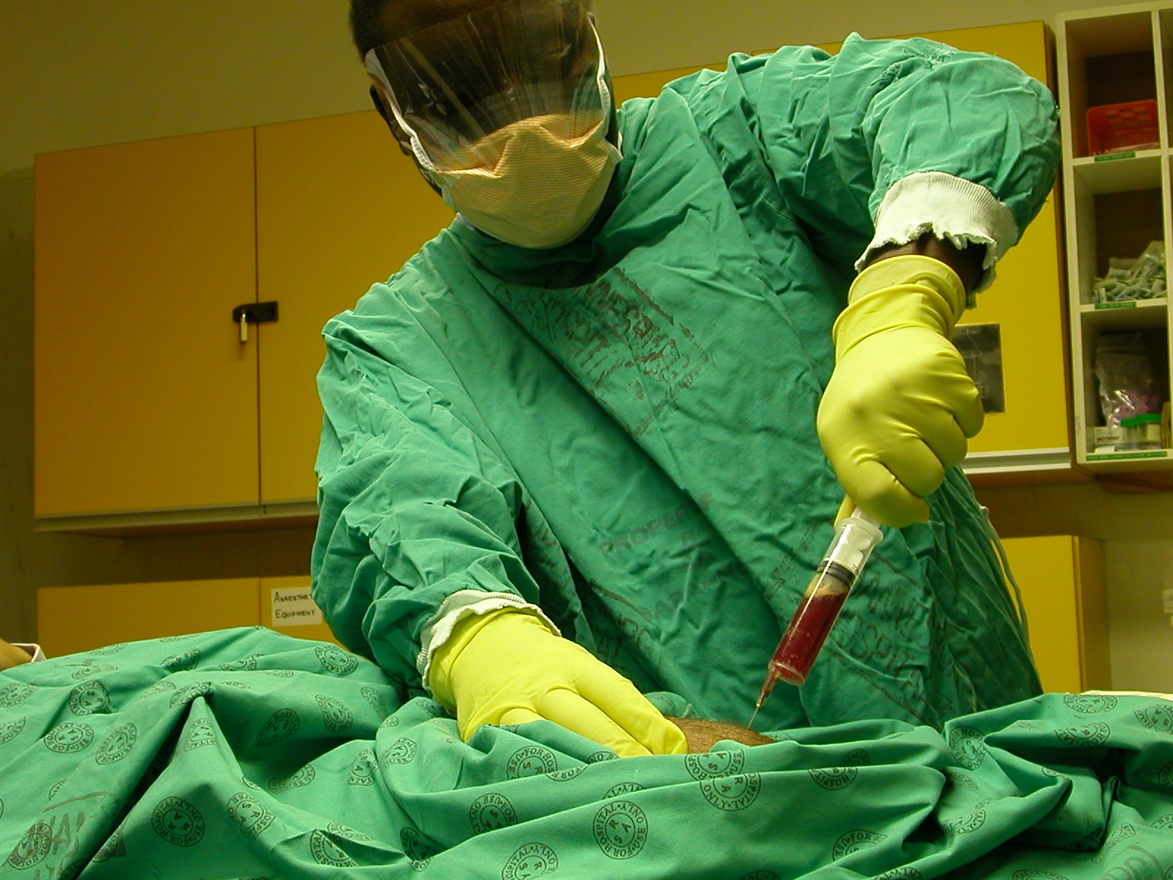
Hemarthrosis Arthrocentesis
Recommendation 7.2.11 For hemophilia patients without inhibitors on factor replacement therapy presenting with joint hemorrhage and persistent pain, arthrocentesis is recommended only if there is a tense, painful hemarthrosis or suspicion of infection. Routine arthrocentesis is not advised.
REMARK: In many healthcare settings, arthrocentesis is not common practice because of fear of introducing intra-articular infection.

Slide 22
Management of hemarthrosis
Early diagnosis
Early treatment
Adjunctive therapy
Rehabilitation
Symptoms
Signs
Replacement therapy
Pain management
RICE
Arthrocentesis
ROM
Function
RICE, rest ice compression elevation; ROM, range of motion.

Slide 23
Hemarthrosis Rehabilitation
Recommendation 7.2.7 In hemophilia patients with hemarthrosis, weight-bearing should be avoided until the symptoms improve to an extent that the patient is comfortable to weight bear without significant pain.
The affected joint should be monitored throughout physical therapy and assessed whether hemostatic treatment is needed
The patient should continue active exercises and proprioceptive training until:
Complete pre-bleed joint range of motion and functioning are restored
Signs of acute synovitis have dissipated

Slide 24
Hemarthrosis Rehabilitation
Recommendation 7.2.9 In hemophilia patients with hemarthrosis, physical therapy exercises performed under clotting factor coverage should begin as soon as the pain symptoms stop.
Recommendation 7.2.10 In hemophilia patients with hemarthrosis, the aim of physical therapy should be to return joint function to the pre-bleed state.

Slide 25
Specific bleeding sites
Hemarthrosis
Soft tissues
Central Nervous System
Lacerations
Throat, neck
37 consensus recommendations
Epistaxis
GI bleeds
Oral
Ophthalmic
Renal
GI, gastrointestinal.

Slide 26
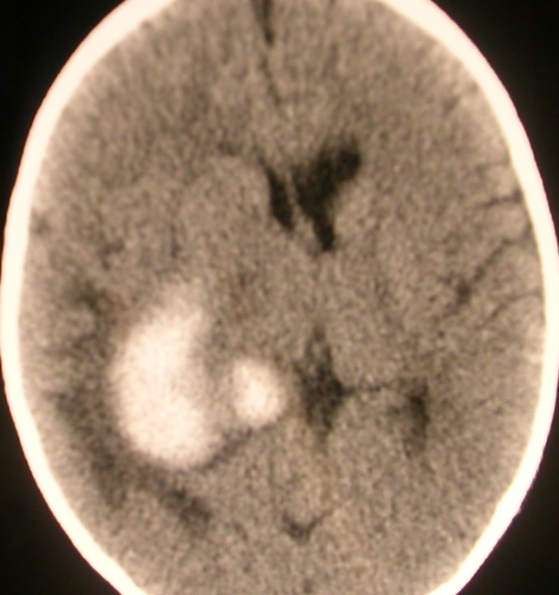
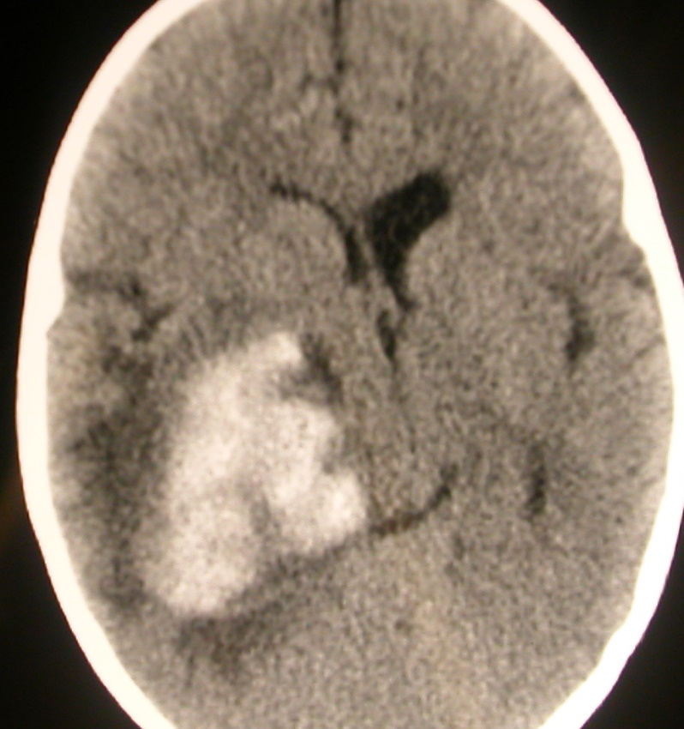
Central nervous system and intracranial hemorrhage
Presentation
At 3 hours

Slide 27
Central nervous system and intracranial hemorrhage
Early replacement therapy should precede diagnostic workup
Recommendation 7.3.1 In hemophilia patients presenting with suspected central nervous system bleeds or bleed-related symptoms, clotting factor replacement therapy should be administered immediately before investigations are performed.
Recommendation 7.3.2 In patients with hemophilia presenting with suspected central nervous system bleeding that could be life-threatening, clotting factor replacement therapy should be administered immediately before investigations are performed and continued until the bleed resolves.*
*Please consult publication for associated remarks.

Slide 28
Specific bleeding sites
Hemarthrosis
Soft tissues
Central Nervous System
Lacerations
Throat, neck
37 consensus recommendations
Epistaxis
GI bleeds
Oral
Ophthalmic
Renal
GI, gastrointestinal.

Slide 29
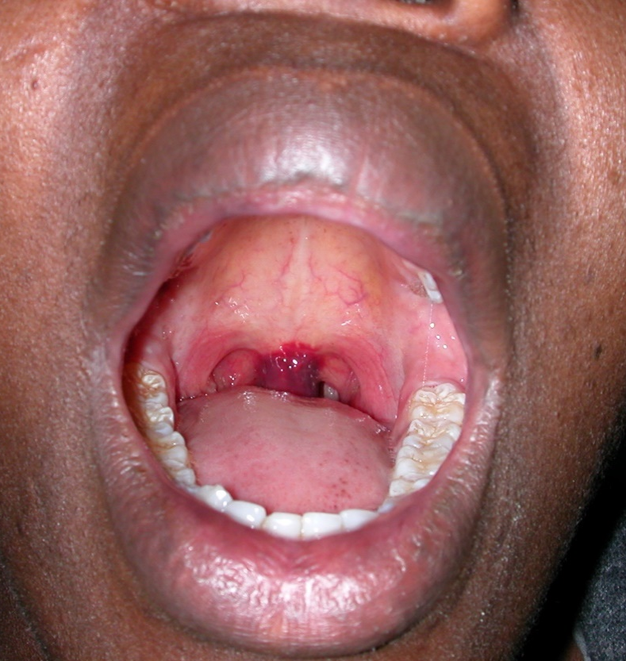
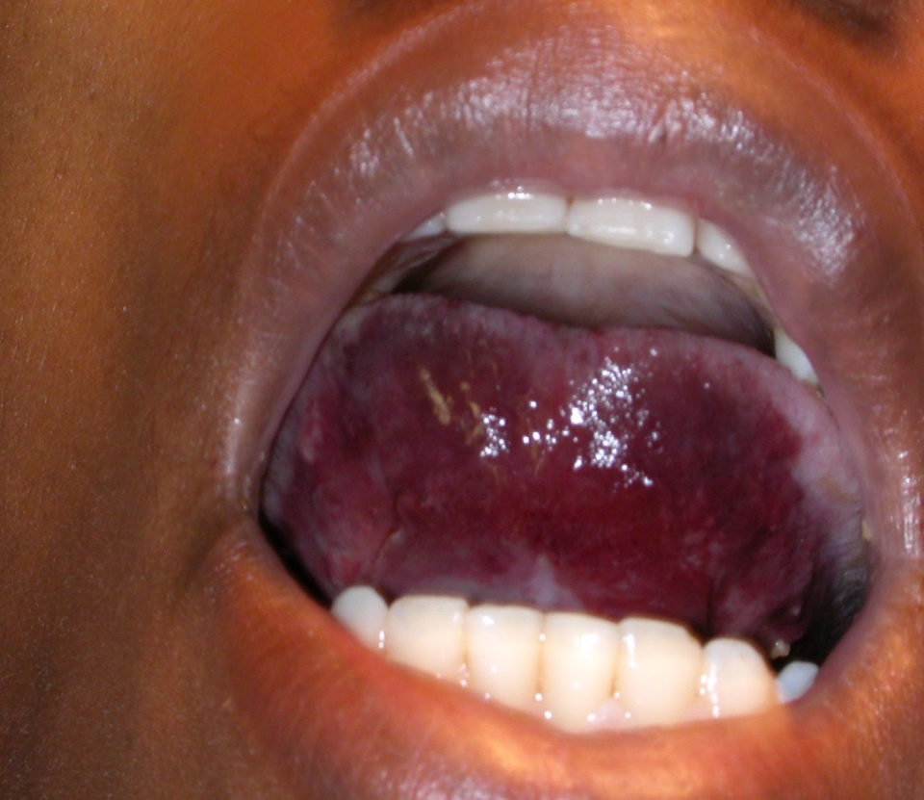
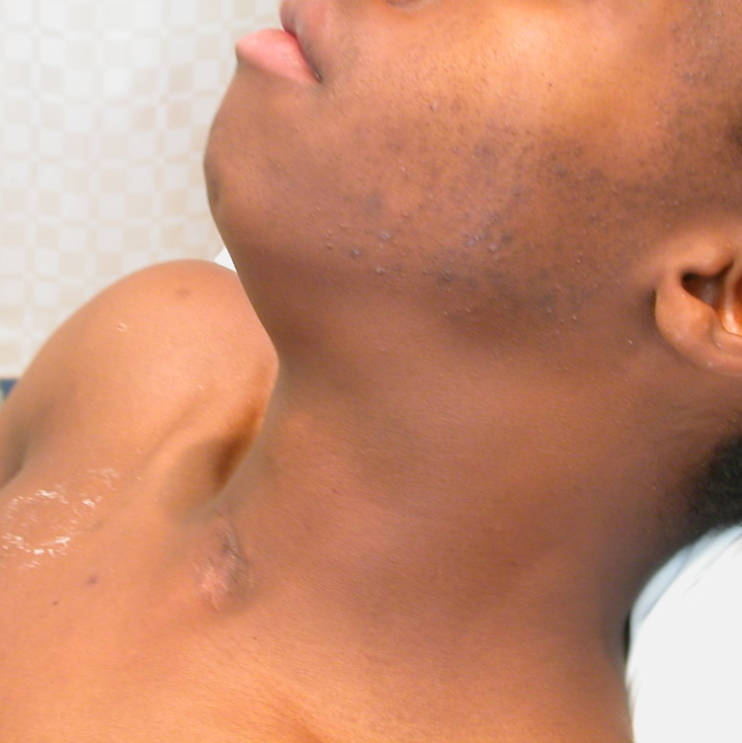
Throat and neck hemorrhage

Slide 30
Throat and neck hemorrhage
Recommendation 7.4.1 In hemophilia patients with throat and neck bleeding, clotting factor replacement therapy should be administered immediately and critical care evaluation sought.
Recommendation 7.4.2 In hemophilia patients with throat and neck bleeding, including injury of the tongue, clotting factor replacement therapy should continue until the bleeding symptoms have resolved.
Recommendation 7.4.3 In hemophilia patients with throat and neck bleeding and local infection, antifibrinolytics should be started to treat the bleed and antibiotics to treat the infection.

Slide 31
Table 7-2
Notes : In this table, the desired peak factor levels of CFC replacement shown for treatment of hemorrhages at different anatomical sites represent the ranges in global practice patterns depending on available resources. Importantly, it should be recognized that the goal of such treatment is effective control of bleeding and should be the same everywhere in the world. Lower CFC replacement levels require much closer observation for effectiveness of bleeding control, with a potentially greater chance of requiring additional CFC replacement to achieve the target plasma level as well as the hemostatic and musculoskeletal outcomes.
ª May be longer if response is inadequate. ^{b} Sometimes longer as secondary prophylaxis during physical therapy. ^{C} The duration of treatment refers to sequential days post-surgery. Type of CFC and patient's response to CFC should be taken into account. ^{D} Depending on procedure; the number of doses would depend on the half-life of the CFC used.

Slide 32
Conclusions
Early diagnosis is crucial to successful management of specific hemorrhages
Early treatment with clotting factor replacement therapy is the standard of care in all bleeding sites
Treatment should be given in sufficient quantity and duration to achieve hemostasis
Treatment of specific hemorrhages should ideally be individualized and target outcomes be defined per site of bleeding
Both low dose and higher dose practice patterns are acceptable in the management of specific bleeds in hemophilia

Slide 33
Thank you to the Hemophilia Alliance for their support in developing this presentation

