Slide 1
Hemophilia Guidelines for All
A new ambition of the World Federation of Hemophilia

Slide 2
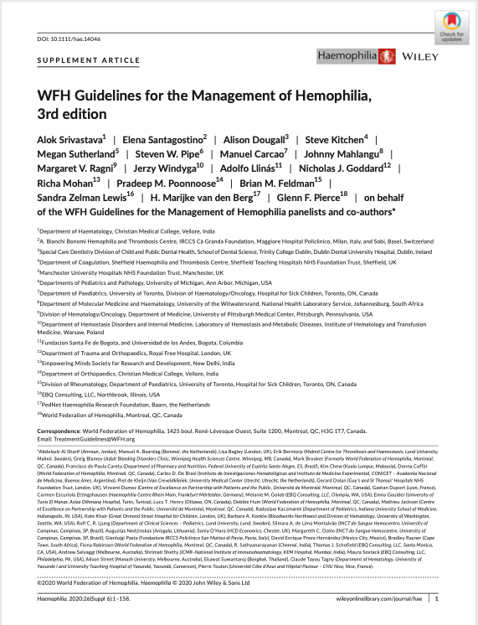
WFH Guidelines for the Management of Hemophilia
All recommendations are consensus based.
Srivastava A et al. Haemophilia. 2020;26(Suppl 6):1–158.

Slide 3
Chapter 8: Inhibitors to Clotting Factor
Margaret Ragni, MD, MPH
Professor of Medicine and Clinical Translational Science
Department of Medicine, Division Hematology/Oncology
University of Pittsburgh Medical Center
Director, Hemophilia Center of Western PA
Pittsburgh PA

Slide 4
Disclosures: Margaret V. Ragni
Grant/Research Support
Alnylam/Sanofi, BioMarin, Bioverativ/Sanofi, Takeda/Shire, Sangamo, Spark Therapeutics
Advisory Boards
Alnylam/Sanofi, BioMarin, Takeda/Shire, Spark Therapeutics

Slide 5
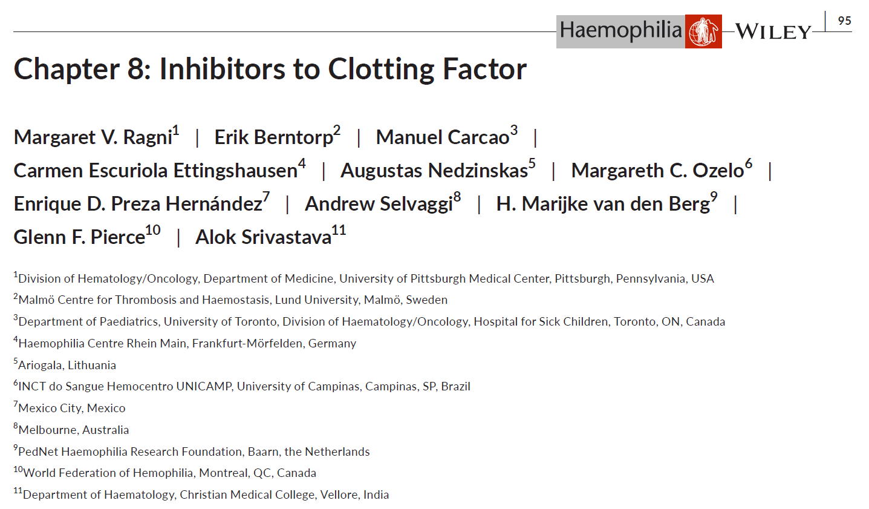
Authors
Margaret V. Ragni
Erik Berntorp
Manuel Carcao
Carmen Escuriola Ettingshausen
Augustas Nedzinskas (PWH)
Margareth C. Ozelo
Enrique D. Preza Hernández (PWH)
Andrew Selvaggi (PWH)
H. Marijke van den Berg
Glenn F. Pierce
Alok Srivastava
PWH, person with hemophilia.

Slide 6
Introduction
“Inhibitors” in hemophilia are IgG alloantibodies to exogenous clotting FVIII or FIX that neutralize the function of infused CFCs
Inhibitors are detected and quantified by the Nijmegen-modified Bethesda assay
Inhibitors are encountered in patients with severe disease and more often
in Hemophilia A than Hemophilia B
Inhibitors are associated with a higher disease burden, including:
  More serious bleeding & complications
  More allergic reactions
  Higher rate of hospitalization
  Greater treatment costs
  Higher mortality rate
CFC, clotting factor concentrates.

Slide 7
What’s New
Bleed management
Inhibitor screening
Immune tolerance induction
Surgery and invasive procedures
Product switching

Slide 8
Clinical Case @ 11 months
Severe hemophilia A
Large gluteal hematoma and small scattered hematomas over the last week
He has been on on-demand rFVIII for a target right knee bleed, but it is poorly responsive to his usual rFVIII
No family history of inhibitors, but a 3-year-old cousin also has severe hemophilia A
At the HTC visit, laboratory tests reveal: Hgb 11.0 g/dL, FVIII <0.01 IU/ml, and anti-FVIII 12.0 BU
How to treat bleeds now that he has an inhibitor? They also wonder if his cousin should be tested for inhibitors
BU, Bethesda unit; Hgb, hemoglobin; HTC, hemophilia treatment centre; IU, international units.

Slide 9
Hemophilia A and FVIII inhibitors
Management of bleeding
Recommendation 8.3.1
For patients with hemophilia A and FVIII inhibitors who develop an acute bleed, the WFH recommends that treatment be based on whether the inhibitor is low-responding or high-responding.
 | Low-responding inhibitors | High-responding inhibitors
Agent | FVIII | rFVIIa or aPCC or FVIII*
Monitoring | FVIII activity (FVIII:C) assay | Thromboelastography/thrombin generation
* In high-responding inhibitors, with low inhibitor titer, FVIII may be used, monitoring for anamnestic response.
aPCC, activated prothrombin complex concentrate.

Slide 10
Hemophilia B and FIX inhibitors
Management of bleeding
Recommendation 8.4.1
For patients with hemophilia B who develop anaphylaxis to FIX therapy, the WFH recommends screening for an inhibitor to FIX, as an allergic reaction may be the first sign of inhibitor development.
Recommendation 8.4.8
For patients with hemophilia B and high-responding FIX inhibitors, the WFH prefers rFVIIa over aPCC to treat acute bleeds, as aPCC contains FIX and may cause or worsen an allergic reaction.
 | Low-responding inhibitors | High-responding inhibitors
Agent | FIX | rFVIIa or aPCC**
Monitoring | FIX activity (FIX:C) assay | Thromboelastography/thrombin generation
**With FIX-containing products, there is risk for allergic reactions, nephrotic syndrome.
aPCC, activated prothrombin complex concentrate.

Slide 11
Indications for inhibitor testing
Table 8-1
After initial factor exposure, at least every 6-12 months, then annually [8.2.1]
After intensive factor exposure, e.g. >5 days, within 4 weeks of last exposure
For recurrent bleeds or target joint bleeds, despite adequate CFC replacement therapy
For failure to respond to adequate CFC replacement therapy
For lower factor recovery or half-life than expected after CFC replacement therapy
For suboptimal clinical or laboratory response to CFC replacement therapy
Before surgery
For suboptimal postoperative response to CFC replacement therapy
CFC, clotting factor concentrate.

Slide 12
Clinical Case
The bleeds resolve with rFVIIa. You introduce the concept of ITI with the parents
  They ask what is the most effective approach to rid the inhibitor and if a port is needed
They recently attended the INHIBITOR summit and met several families who had a good experience with emicizumab
If they decide to switch to emicizumab will it rid the inhibitor, or can the inhibitor “come back” years later?
How would they treat bleeds?
Brand name of emicizumab is Hemlibra®
ITI, immune tolerance induction.

Slide 13
Immune tolerance induction (ITI)*
 | Hemophilia A patients with inhibitors | Hemophilia B patients with inhibitors
Drug | rFVIII, pdFVIII, rFVIIIFc – success 70% | rFIX – success lower than in HA
Dose | rFVIII: 200 IU/kg daily | High-dose (as in HA); consider immunosuppression
Success | Persistently negative titer, recovery > 66%, half-life > 6 hours | Persistently negative titer
Failure | If ITI unachieved in 2-3 years | rFIX may increase allergic reactions, nephrotic syndrome
* Few data exist on ITI in hemophilia B, so WFH makes no specific recommendations for hemophilia B ITI.
HA, hemophilia A; ITI, immune tolerance induction.

Slide 14
Immune tolerance induction
General guidance
All inhibitor patients should undergo a trial of ITI [8.3.16]
Data on the impact of EHL products in ITI are limited
After successful ITI, FVIII prophylaxis should be initiated, with close monitoring of clinical response
Non-factor therapies may reduce disease burden [8.3.19]
Use of non-factor therapies in ITI is not established
EHL, extended half-life; ITI, immune tolerance induction.

Slide 15
Immune tolerance induction
When should ITI be initiated?
ITI should start immediately after detection, no matter the titer
What agent should be used in ITI?
The optimal regimen is undefined; rFVIII 100 IU/kg/day preferred
How should bleeds be managed in ITI?
In LR, rFVIII should be used to treat acute bleeds
In HR, rFVIIa or aPCC* bypass; or, if low titer, FVIII is advised
How should ITI-refractory or ITI-naïve be managed?
Emicizumab prophylaxis is recommended over rFVIIa
Can ITI be delayed, avoided?
Whether ITI can be delayed or avoided is unknown
*aPCC should be avoided in those taking emicizumab prophylaxis to avoid TMA (thrombotic microangiopathy)
aPCC, activated prothrombin complex concentrate; HR, high responders; ITI, immune tolerance induction; LR, low responders.

Slide 16
Bleed management and emicizumab
Recommendation 8.3.17
For patients with hemophilia A and persistent inhibitors who fail immune tolerance induction (ITI) or never underwent ITI, the WFH recommends emicizumab prophylaxis over bypass agent prophylaxis (rFVIIa or aPCC), as emicizumab is more effective in bleed prevention and simpler to administer, as it is given weekly and subcutaneously.
Recommendation 8.4.10
For patients with hemophilia B and inhibitors, the WFH is unable to make a recommendation on the use of immune tolerance induction, as experience with ITI in hemophilia B is limited.
REMARK: In patients with hemophilia B and inhibitors in whom ITI is attempted, high-dose factor replacement protocols should be followed similar to what is recommended for hemophilia A, with strong consideration for the use of immunosuppression. It should be noted the risk of nephrotic syndrome may increase with high-dose ITI.
aPCC, activated prothrombin complex concentrate, ITI, immune tolerance induction.

Slide 17
Bleed management and emicizumab
Hemophilia A patients with inhibitors on emicizumab prophylaxis
 | Low-responding inhibitors | High-responding inhibitors
Agent | FVIII | rFVIIa preferred over aPCC due to TMA* risk
Monitoring | Bovine reagent-based chromogenic assay (bovine FX in kit reagent) | Thromboelastography/thrombin generation
*TMA is thrombotic microangiopathy, which has been reported in patients receiving aPCC and emicizumab.
Close monitoring is recommended in those with thrombosis risk factors: past VTE, obesity, smoking, chronic infection and inflammation; and also in those receiving rFVIIa in whom risk appears low.
aPCC, activated prothrombin complex concentrate.
Adamkewicz JI, Haemophilia 2017;23:11-17; Levy GG, JTH 2019;17:1470-77; Neufeld EJ, Blood Rev 2015; 29(Suppl 1): S34-41.

Slide 18
Bleed management and emicizumab
Recommendation 8.3.2
For patients with hemophilia A and inhibitors who have acute bleeds, the WFH recommends FVIII concentrate for those with low-responding inhibitors, and a bypassing agent (recombinant factor VIIa [rFVIIa] or activated prothrombin complex concentrate [aPCC]) for those with high-responding inhibitors.*
REMARK: In patients receiving emicizumab who receive FVIII concentrate, the WFH recommends bovine reagent chromogenic FVIII assays (bovine FX in kit reagent) to measure plasma FVIII:C activity and inhibitor titer levels.
Recommendation 8.3.4
For patients with hemophilia A and high-responding FVIII inhibitors receiving emicizumab who develop an acute bleed, the WFH prefers rFVIIa over aPCC to avoid the risk of thrombotic microangiopathy.
  *Please consult publication for associated remarks.
aPCC, activated prothrombin complex concentrate.

Slide 19
Clinical case
The child’s maternal uncle is a 43-year-old man with severe hemophilia A and past anti-FVIII 5.7 BU. He was begun on ITI 2 years after inhibitor detection but was refractory to ITI, so he has been taking rFVIIa for bleeds
Now he has painful arthritis of the right ankle. The surgeon says ankle fusion surgery is indicated. Lab studies reveal anti-FVIII 4.5 BU
He says his nephew recently started weekly emicizumab and he would also like to switch, but he has a few questions:
Can he switch to emicizumab or should he wait until after surgery?
Once he switches, can he still take rFVIIa to treat bleeds?
BU, Bethesda unit; ITI, immune tolerance induction.

Slide 20
Surgery and invasive procedures
General recommendations
Determine factor coverage, bypass, follow-up; or use adjusted-dose continuous infusion
Once hemostasis is achieved, maintain regimen 3-5 days, then taper over 1-3 weeks
 | Low-responding inhibitors | High-responding inhibitors
HA-I, HB-I | Higher, more frequent doses or adjusted-dose continuous infusion | Single-agent bypass (rFVIIa or aPCC) or, if fails, consider sequential bypass
HA-I Emicizumab prophylaxis | FVIII products advised for surgery | rFVIIa preferred over aPCC for surgery
HB-I Factor IX allergy | rFVIIa advised for surgery | rFVIIa is advised for surgery
aPCC, activated prothrombin complex concentrate; HA-I, hemophilia A with inhibitor; HB-I, hemophilia B with inhibitor.

Slide 21
Surgery and invasive procedures
Recommendation 8.3.10
For patients with hemophilia A and low-responding FVIII inhibitors who undergo surgery or an invasive procedure, the WFH suggests higher, more frequent FVIII product dosing than usual due to the short half-life of FVIII.*
Recommendation 8.3.11
For patients with hemophilia A and high-responding FVIII inhibitors who undergo surgery or an invasive procedure, the WFH recommends bypass agent therapy (rFVIIa or aPCC) at the discretion of the clinician. If single-agent bypass fails, sequential bypass agent treatment, i.e., rFVIIa alternating with aPCC, is another therapeutic approach. The WFH also recommends close clinical monitoring for thrombosis.
  *Please consult publication for associated remarks.
aPCC, activated prothrombin complex concentrate.

Slide 22
Surgery and invasive procedures
General recommendations
Determine factor coverage, bypass, follow-up; or use adjusted-dose continuous infusion
Once hemostasis is achieved, maintain regimen 3-5 days, then taper over 1-3 weeks
 | Low-responding inhibitors | High-responding inhibitors
HA-I, HB-I | Higher, more frequent doses or adjusted-dose continuous infusion | Single-agent bypass (rFVIIa or aPCC) or, if fails, consider sequential bypass
HA-I Emicizumab prophylaxis | FVIII products advised for surgery | rFVIIa preferred over aPCC for surgery
HB-I Factor IX allergy | rFVIIa advised for surgery | rFVIIa is advised for surgery
aPCC, activated prothrombin complex concentrate; HA-I, hemophilia A with inhibitor; HB-I, hemophilia B with inhibitor.

Slide 23
Surgery and invasive procedures
Recommendation 8.3.12
For patients with hemophilia A and inhibitors receiving emicizumab who undergo major surgery or an invasive procedure, the WFH recommends a FVIII-containing product for those with low-responding inhibitors. The WFH prefers rFVIIa over aPCC for those with high-responding inhibitors due to the risk of thrombotic microangiopathy. The WFH makes no recommendations on specific dose, frequency, or duration as there are insufficient data.
REMARK: Caution is urged when rFVIIa is used in patients receiving emicizumab who have risk factors for thrombosis (e.g., past venous thromboembolism, obesity, smoking, chronic infection, inflammation) due to the risk of acute non-STEMI and pulmonary embolism.
Recommendation 8.4.12
For patients with hemophilia B and FIX inhibitors who undergo surgery, the WFH recommends rFVIIa over aPCC, as aPCC contains FIX and may cause or worsen an allergic reaction.
aPCC, activated prothrombin complex concentrate.

Slide 24
Conclusions
All inhibitor patients should undergo a trial of ITI
Data on impact of EHL products on ITI are limited
After successful ITI, FVIII prophylaxis should be initiated
For hemostasis in surgery in inhibitor patients on emicizumab, use rFVIIa
Bleeds while on emicizumab should be managed with rFVIIa
Non-factor therapy prophylaxis may reduce disease burden
Use of non-factor therapies in ITI is not established
EHL, extended half- life; ITI, immune tolerance induction.

Slide 25
Thank you to the Hemophilia Alliance for their support in developing this presentation

